Slide 1
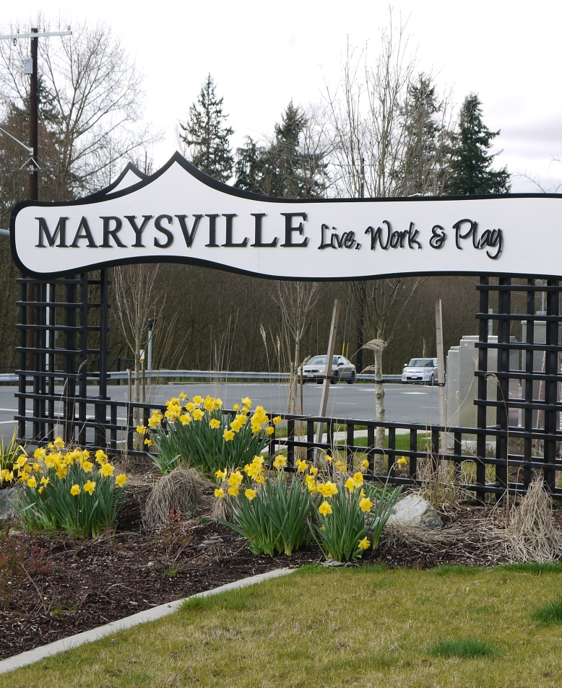


City of Marysville
2015 Transportation Element
Presented by

Slide 2
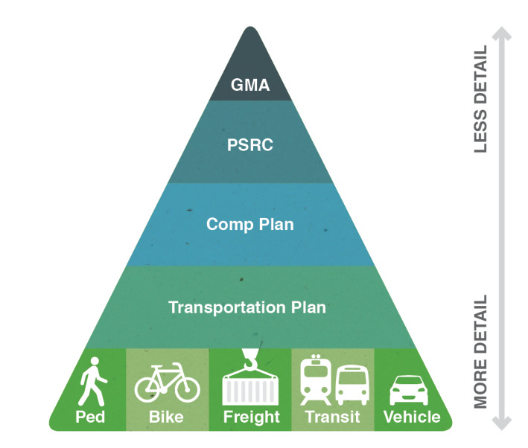
Transportation Element Objectives
Support overall Comprehensive Plan and City vision
Meet requirements of the Growth Management Act (GMA) and Vision 2040
Refine pedestrian and bicycle system improvements
Integrate and prioritize transportation improvements serving all modes
Review and update transportation policies
Revisit level of service standards/concurrency program
Update transportation funding analyses
and strategies

Slide 3
Land Use Growth – 2014 to 2035
Incorporates Subarea Plan Updates
Downtown Master Plan
Lakewood Subarea Plan
Others
City/UGA Total
New employees – 20,500 (4.0% growth)
New households – 15,300 (2.0% growth)
Highest Growth Districts
Employees: North Marysville, Arlington
Households: Southeast Marysville
Changes in forecasts since 2008 Element
Households
City annual growth
reduced from
2.3% to 2.0%
Much
less growth
in Lake Stevens
Employees
15,700
more jobs
(Marysville, Arlington, Lake Stevens, and County)
More concentrated
in designated urban areas

Slide 4
Analysis Focus Areas
SR 9 Widening
88th Street NE Widening
I-5/156th Street NE Interchange
51st Avenue NE (and 67th Avenue NE)
State Avenue Widening
Downtown Bypass
Pedestrian System Network
Bicycle System Network

Slide 5
System Plans
Highway and Streets
Pedestrian System
Bicycle System

Slide 6
Transportation Improvement Projects
Project Types
Intersections/Interchanges
New Roadway
Major Widening
Minor Widening/Reconstruction
Non-Motorized Projects
Citywide Programs
Timeframe
Short-Range (2015-2020)
Mid-Range (2021-2026)
Long-Range (2027-2035)

Slide 7
Financing Program – Summary
2015 to 2035
(2015 Dollars)
 | Costs 826 M Total
Revenue 479 M Total | (Unfunded)
HIGH +111 M | Capital Projects 664 M
TREND 368 M
 | 139 M Maintenance and Operations
 | 23 M Bonds

Slide 8
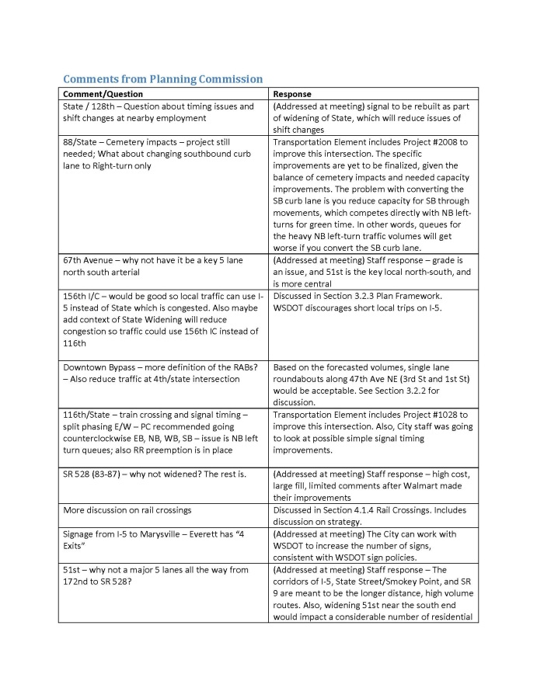
Planning Commission
Presented April 28, 2015
Comments/questions documented
Follow-up analysis
Addressed comments, updated Transportation Element
Staff addressed Commission on June X, 2015

