Slide 1
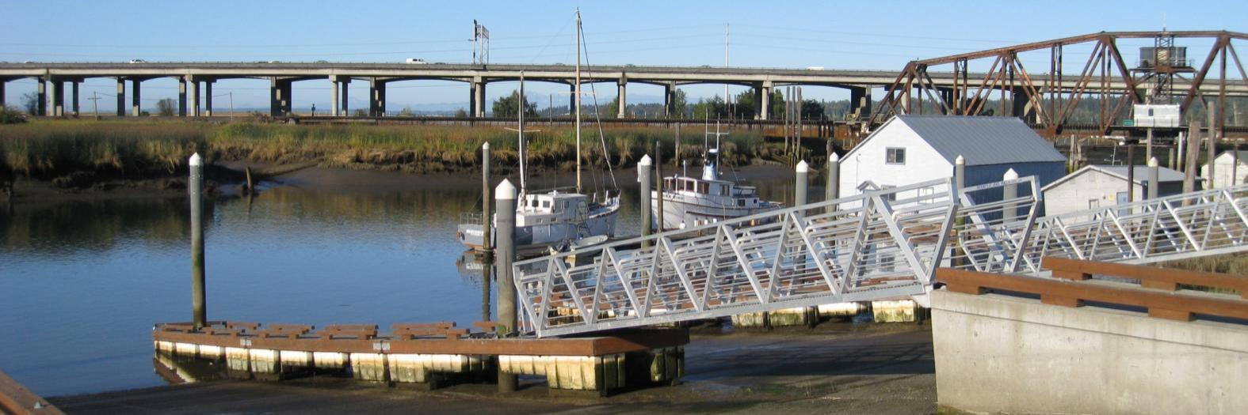
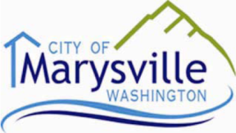

MARYSVILLE WATERFRONT WORKSHOP
DEVELOPMENT PROGRAM
AND RECOMMENDATIONS
PREPARED FOR
PREPARED BY
25 January 2013

Slide 2
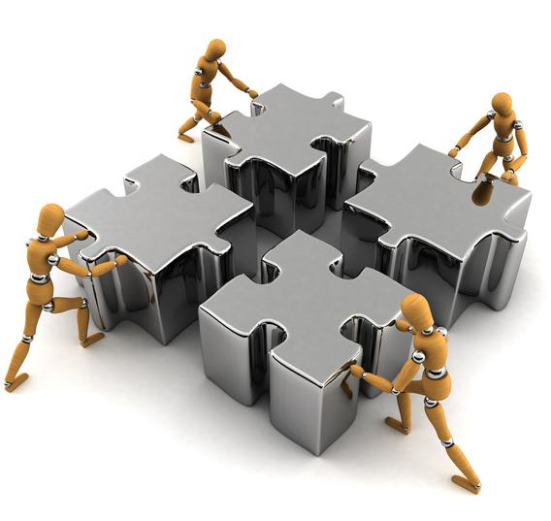
Presentation Outline
Workshop Process
Conditions & Considerations
Demographics
Recommendations

Slide 3
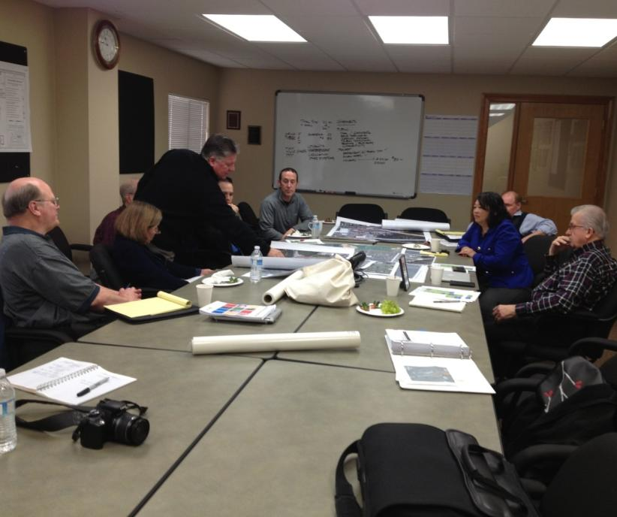
Team and City Staff
City Staff
Mayor Jon Nehring
Gloria Hirashima
Jim Ballew
Kevin Nielsen
Consultant Team
Leland Consulting Group
Makers
Mayer/Reed
BST Associates

Slide 4
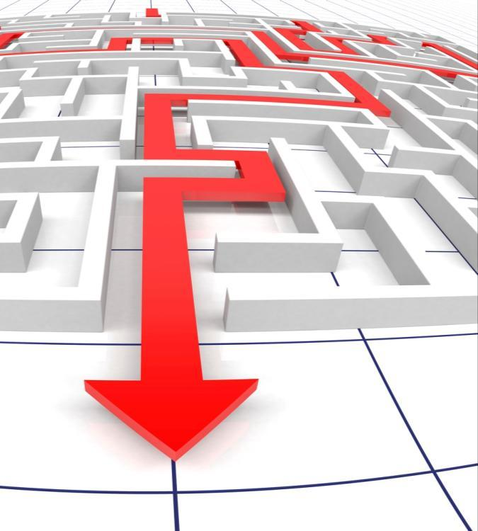
Workshop Purpose
The purpose of this workshop is to define a development strategy for Marysville’s waterfront, such that the City Council can have the confidence to move forward with next steps.

Slide 5
The Workshop Process
Document Review
Site Tour
Kickoff Meeting
City Council Workshop
Team Workshop
Discuss Observations
Define Alternative Strategies
Determine Preferred Strategy
Refine Strategy
Present Recommendations
Day 1
A “collaboration of principals” can, in a short burst of time and with concentrated focus, produce what might otherwise take months of intermittent effort.
Day 2
Day 3

Slide 6
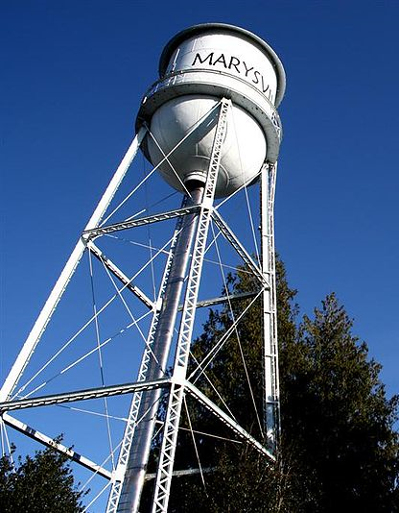
Adopted City Vision & Mission
“Experience Marysville ~ Live, Work, Play”
“The City of Marysville partners with the community to provide quality innovative and efficient municipal services which promote economic growth, thriving neighborhoods, healthful living, and financial sustainability for our residents and businesses.”
Source: Wikipedia

Slide 7
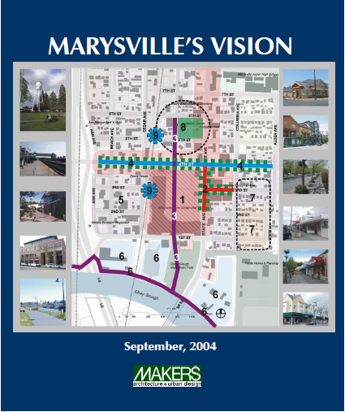
Adopted Goals from Downtown Vision Plan
Land Use, Development, and Community Design
Upgrade the character and identity of downtown as the focal point of Marysville
Foster the creation of sub-districts
Transportation and Streetscape
Enhance pedestrian and vehicular connectivity
Use unified streetscape elements to enhance the sense of identity
Civic, Social, and Cultural
Foster a sense of community
Economic Development
Enhance Marysville’s economic vitality

Slide 8
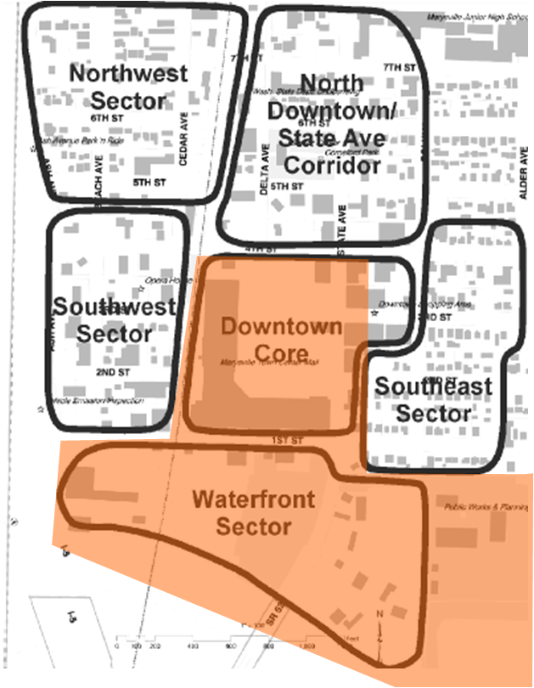
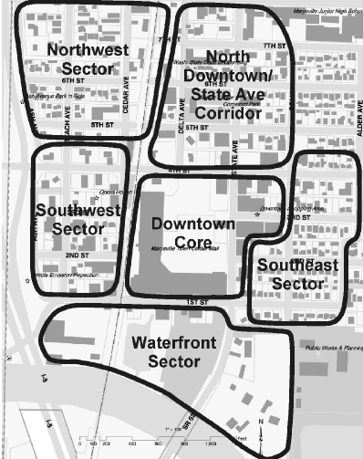
Adopted Vision for the Waterfront District
Promote multi-story mixed-use development.
Upgrade State Avenue to enhance Downtown’s entry.
Upgrade 1st Street to promote access to the Ebey Slough Waterfront Park/Boat Launch.
Promote private investment in waterfront properties.
Continuous pathway along the waterfront.

Slide 9
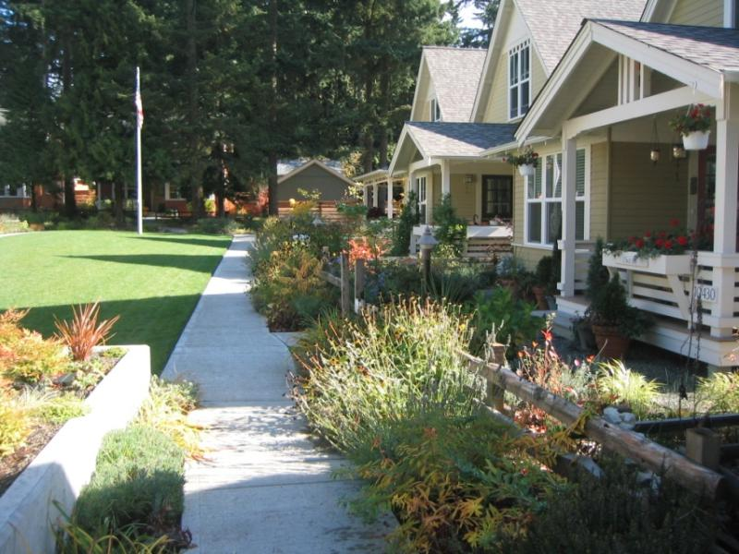
The Premise Being Tested
To evaluate opportunities to establish mixed-use, multi-phase public-private partnerships that will implement public policy, attract investment, and contribute to Marysville and its Downtown.

Slide 10
The Family of Barriers
Physical
Financial
Regulatory
Market
Political
Understand barriers to success—solve early and often.

Slide 11
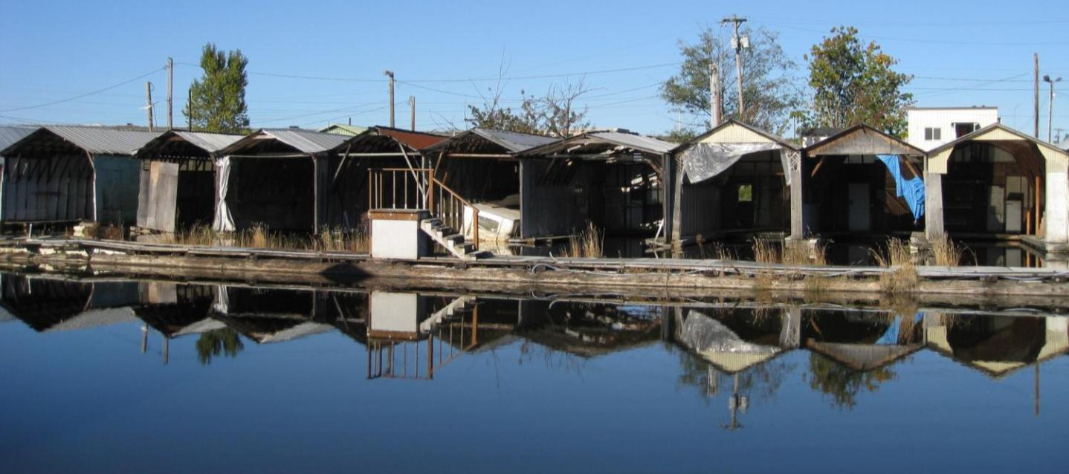
CONDITIONS & CONSIDERATIONS
Notes:
Header
Xxx
Xxx

Slide 12
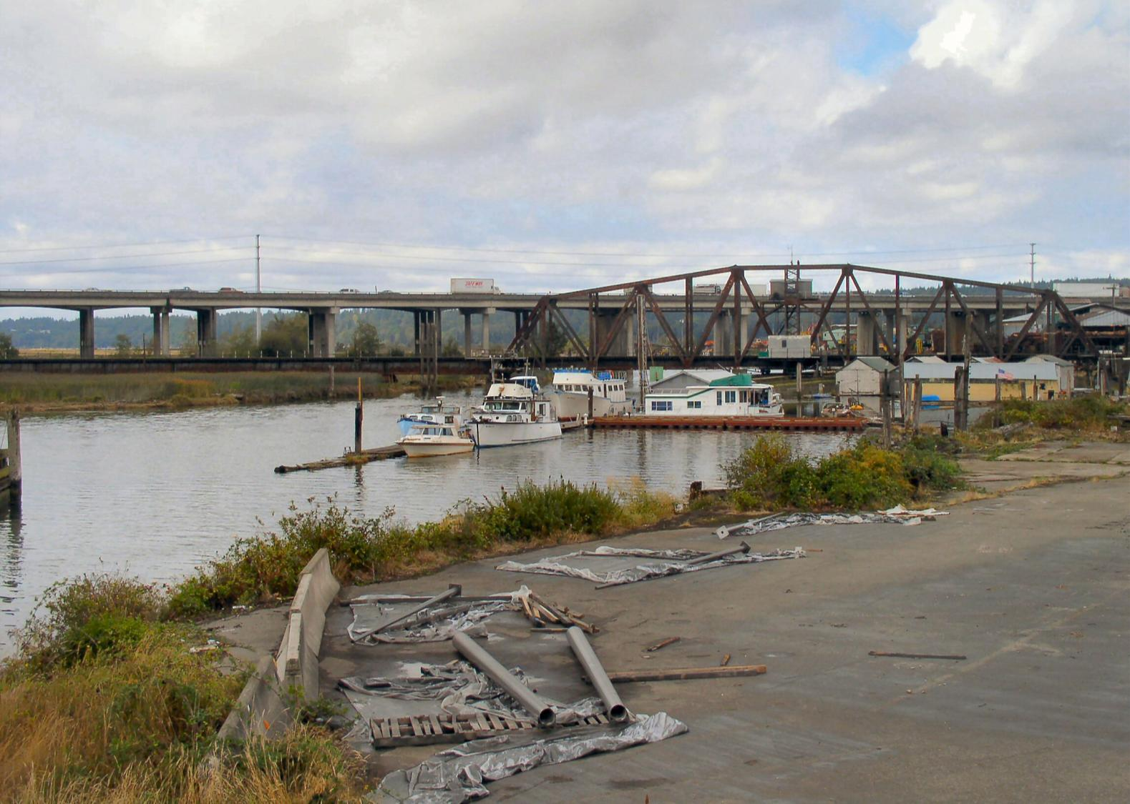

Slide 13
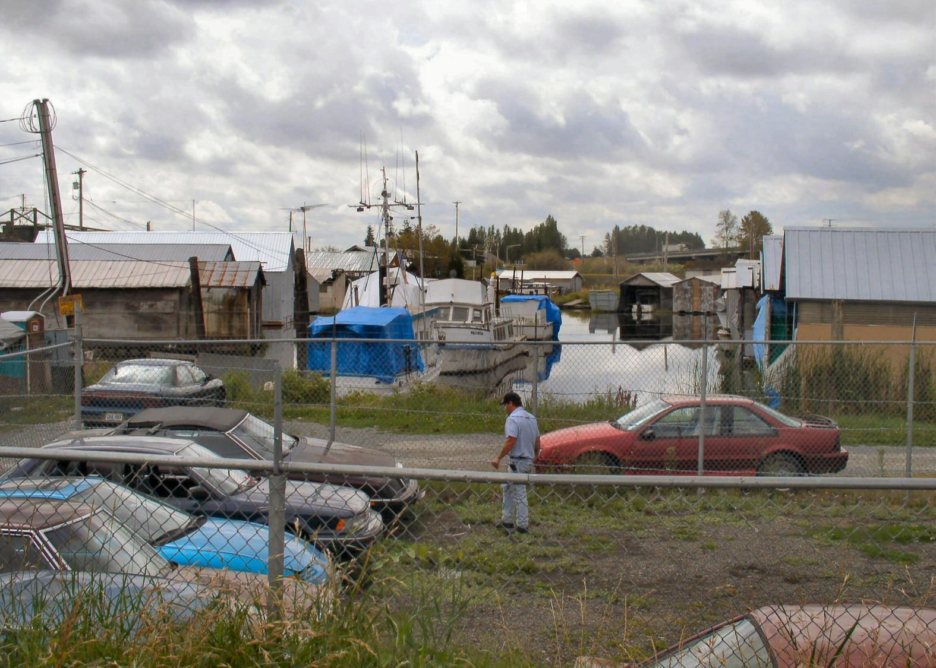

Slide 14
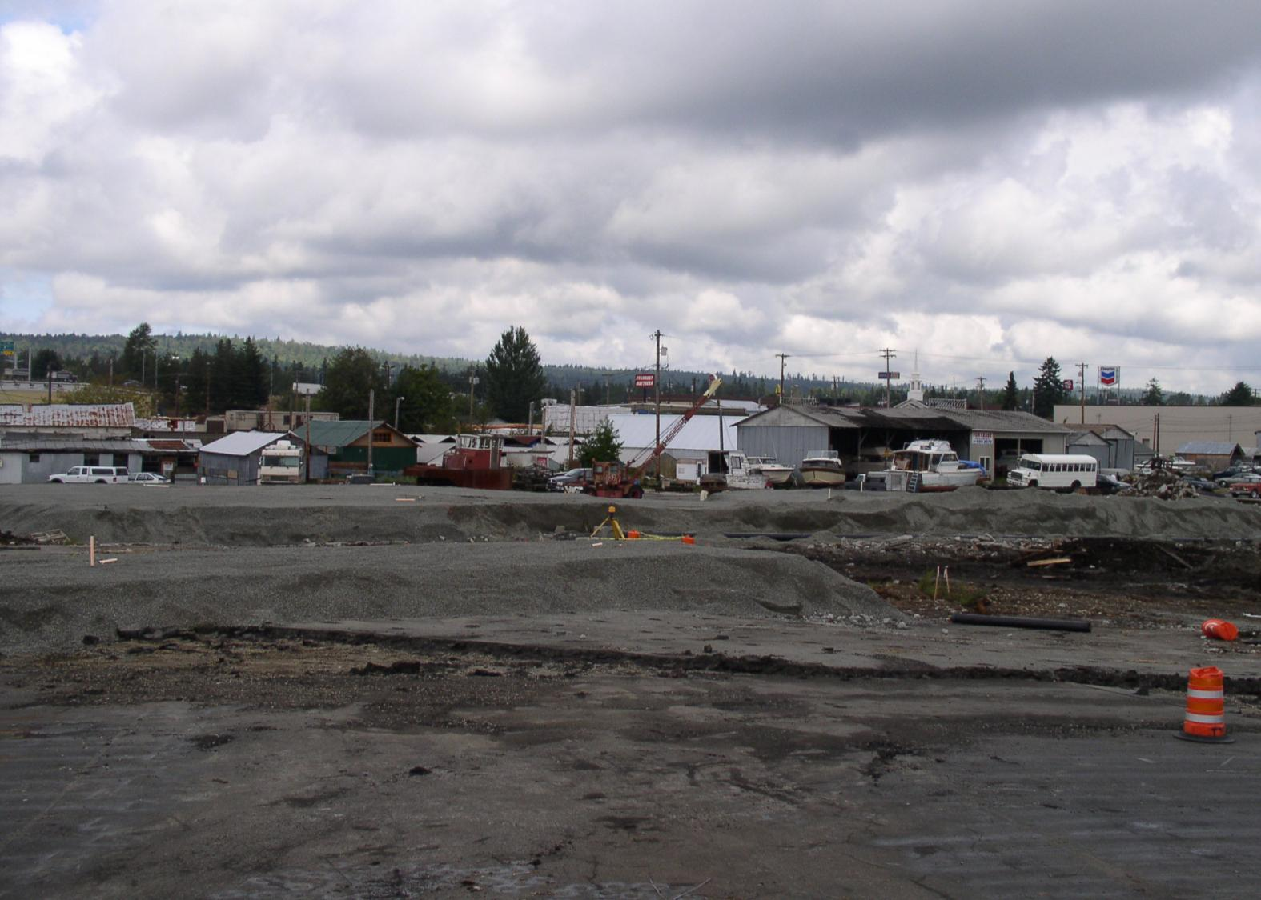

Slide 15
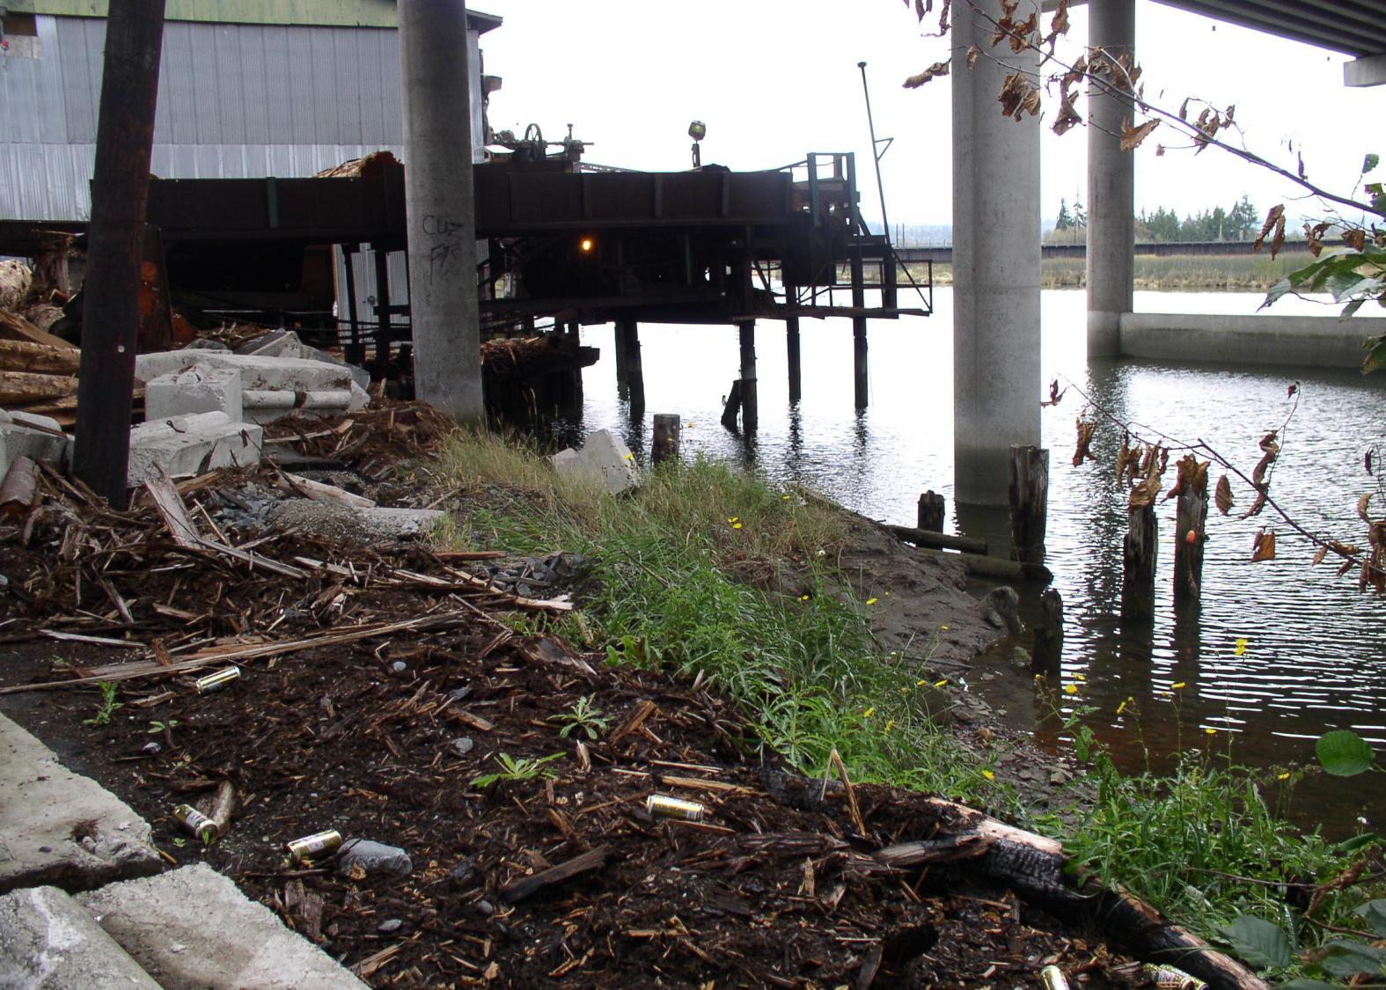

Slide 16
The Team Process and its Considerations
Property size, location, and ownership
Nature and condition of adjacent land uses and activities
Site conditions – soils, utilities, access, floodplain, odor, noise
Regulatory barriers, local, state, federal
Demolition and clean up considerations
Market desirability relative to land uses (rules of real estate)
Cost barriers
Potential positive impact on Downtown
Ability to achieve Strategic Differentiators
Likely potential for developer interest
Probable market acceptance
The former lumber yard is overpriced

Slide 17
The Team Process and its Considerations (cont’d)
The waterfront needs attention
The waterfront is an underutilized asset
Bring people to the waterfront
A small marina is not financially feasible
The boat ramp facility is over parked
Food (dining) offers the best retail option
Retail and office uses will not survive well
Housing offers the best private development option
The Downtown needs more customer support
The Tulalip Tribe is a good neighbor
Avoid expensive acquisitions
Build a community, not a project

Slide 18
The Marina: Washington State Boat Sales
New boats currently account for 9% of sales, which is a slight improvement from last year (7% of sales) but it is still down from the heydays (20% in 2005). Overall sales (thru Sept) declined 1.2% from prior year.
Source: NMTA Data
17

Slide 19
The Marina: Washington New Boat Sales by Range
Growth averaged 9.7%/year from 2003 through 2007 (~490 boats added per year on average). Then sales dropped each year from 2008 to 2012 (~150 new boat sales per year, some going to Canada).
Source: NMTA Data
18

Slide 20
The Marina: Private Marinas are Doing Better, Need to Improve
GBI peaked at $62 mil in 2006 and 2007;
Fell by 44% from peak to 2009;
Gained 17% in 2011 over 2010
Up 19% in Q1 2012 over Q1 2011
Source: Washington State Dept. of Revenue (Gross Business Income)
19

Slide 21
Participation in Selected Outdoor Activities
4.5% of US Population
3.4% of US Population
2.9% of US Population
Source: Outdoor Recreation Participation Report 2012, All Americans Ages 6 and Older

Slide 22
Washington State Recreation Sector
An increasing share of the recreation dollar is spent on fitness clubs and casinos.
GBI up $750 million from 1994 to 2011: fitness centers up $410 mil, casinos up $165 mil, golf up $110 mil (but very little growth since 2002), skiing up $50 mil, marinas up $400k.
Source: Washington State Dept of Revenue (Gross Business Income)
21

Slide 23
Boat Registration per 1,000 Persons
Registrations per 1,000 persons in Snohomish County fell from ~4.0 in 1995 to ~3.2 in 2011. Other Puget Sound and Other Wash performed better.
Source: Washington State Department of Licensing (boats 26 feet & longer)
22

Slide 24
Age Distribution of Boat Owners
Boat owners have gotten older. Today there are fewer owners in their 30s and more in their 50s and 60s. This is especially true for sail boaters, who are loyal to the sport; but sailing is very physical.
Source: Info-Link Technologies Inc.
23

Slide 25
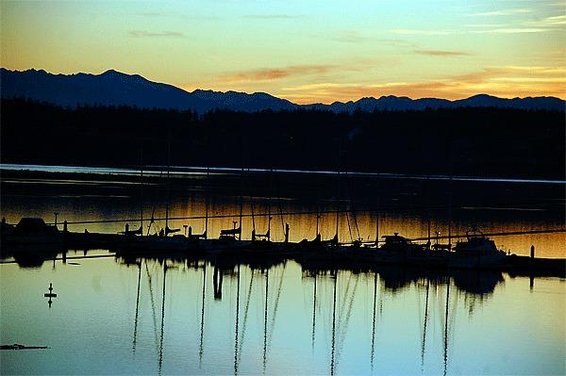
Occupancy decline may sink Oak Harbor marina’s rate hike
The sun sets over Oak Harbor Marina. The facility’s occupancy is dropping and officials hope abandoning a scheduled rate hike will help address the issue. The occupancy rate went from 80 percent in 2009 to its current 56 percent.
~Whidbey News Times Staff reporter
Source: Justin Burnett / Whidbey News-Times

Slide 26
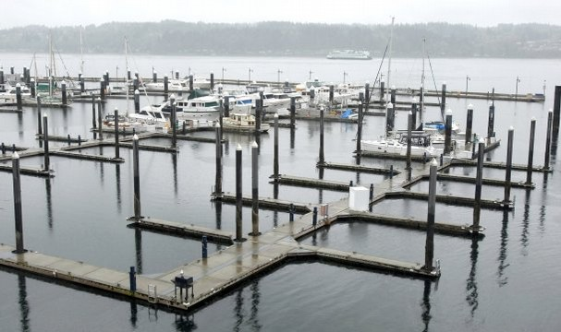
Port of Bremerton Commissioners Reject Proposals to Privatize Marina
BREMERTON — The Port of Bremerton commissioners unanimously rejected proposals from private entities to run the Bremerton Marina. The marina is losing close to $400,000 a year. [40% occupancy rate]
Source: Kitsap Sun staff

Slide 27
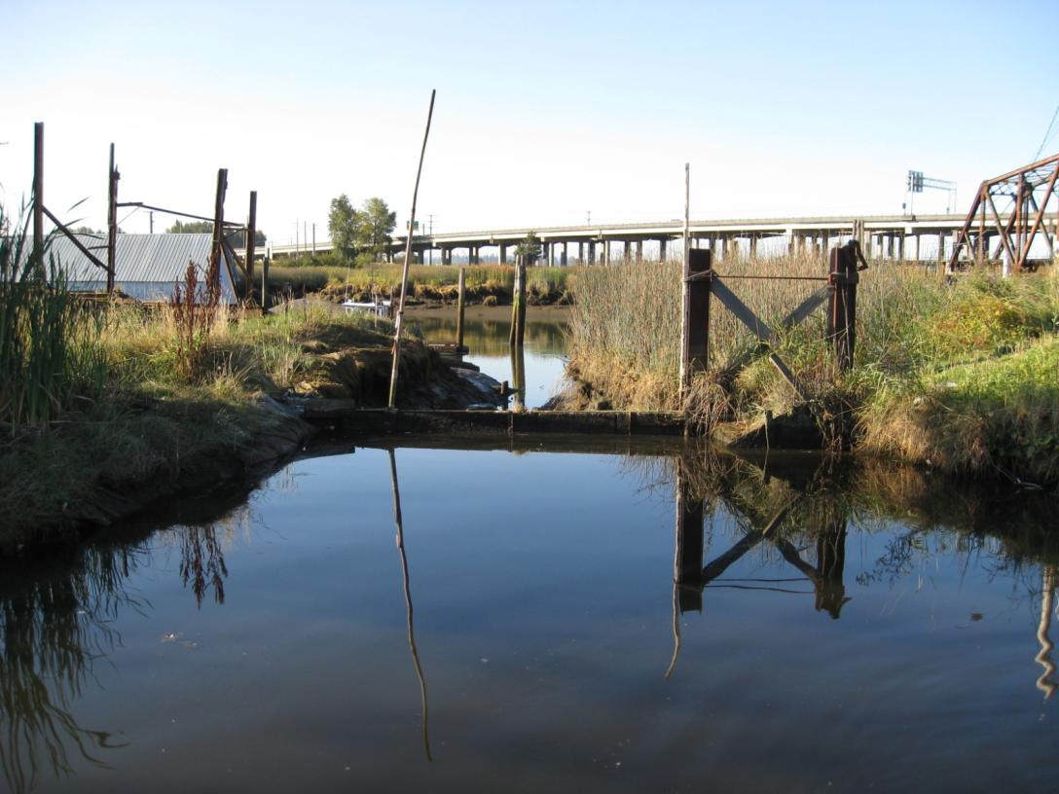
City of Marysville Marina
The existing marina has limited demand. Recommend elimination of the internal marina.
Recommend the City consider additional boat floats toward the RR bridge, and moving the boat houses toward the RR Bridge (if they block upland views).
Boat storage could be considered as an interim use.

Slide 28
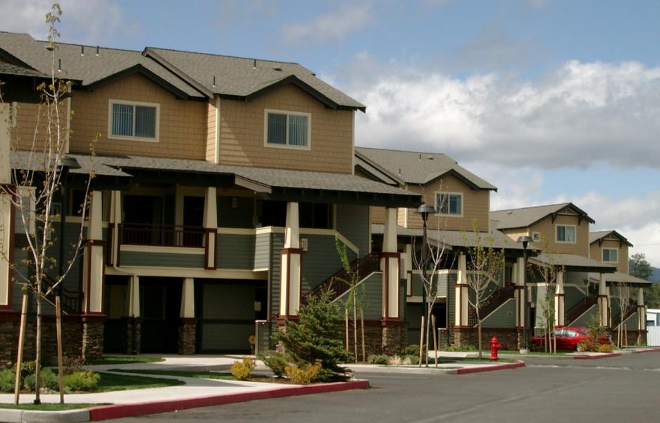
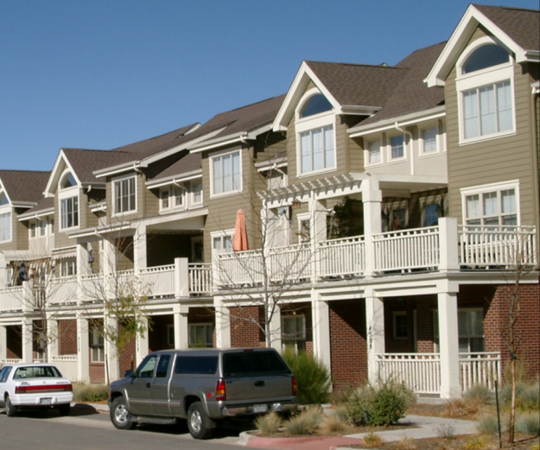
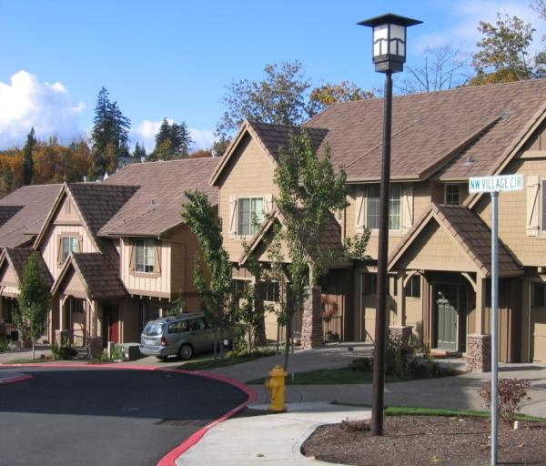
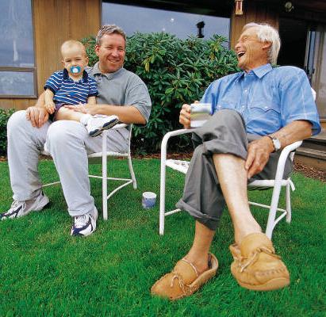
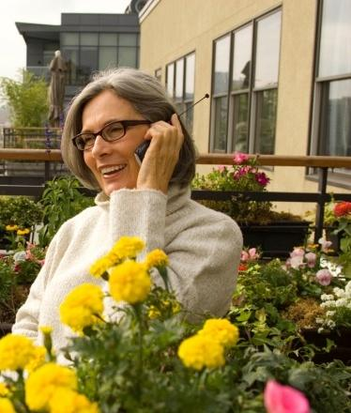
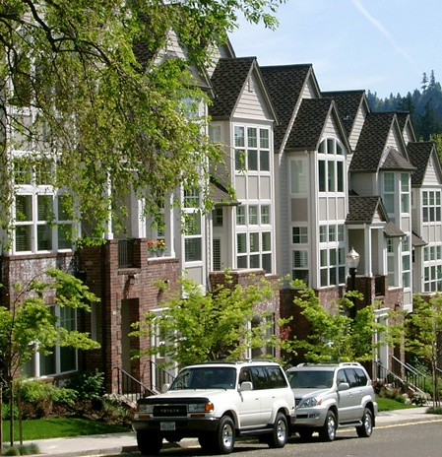
Why Housing?

Slide 29
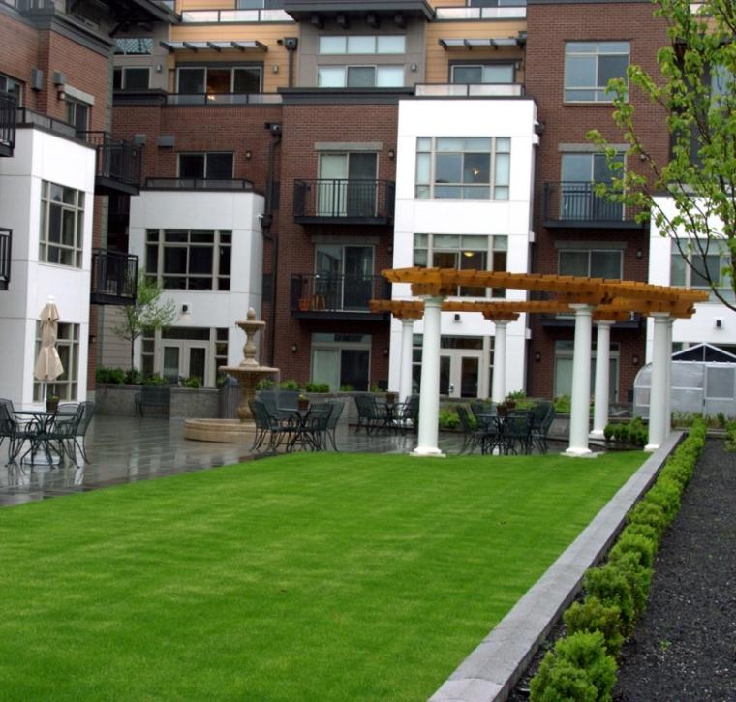
Why Housing?
Most marketable land use
Reinforced by water presence
Able to put large acreage into production and add to tax base
Bring new customers to downtown
Activity and an 18 hour community

Slide 30
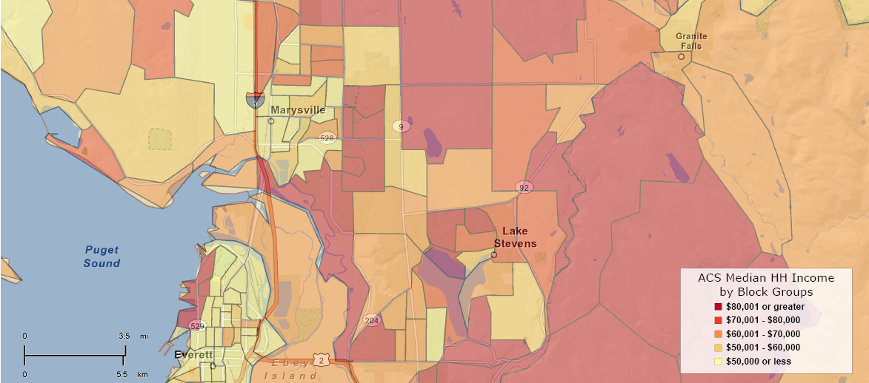
DEMOGRAPHICS

Slide 31
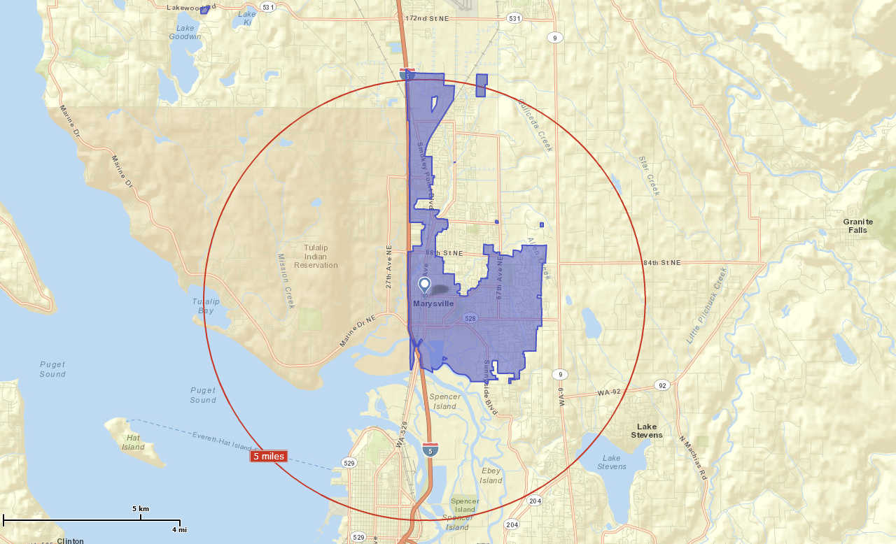
Marysville Market Area
Source: ESRI Business Analyst
Notes:
Header
Xxx
Xxx

Slide 32
Demographic Highlights – City of Marysville
Growing Faster than Snohomish County
Median home value and Per capita income is 20% lower than Snohomish County
Fewer high income households compared to the County
More mid-range housing units than county or 5-mile radius (fewer at the bottom and fewer at the top)
More family households with children than the County

Slide 33
Top 5 Tapestry Segments – City of Marysville
Up and Coming Families
28% (US 3.5%)
Median age 32.6
Mix of Gen X & Baby Boomers
Affluent families with younger children
Diversity increasing
Two-thirds have attended college
Boomburbs
12% (US 2.3%)
Median age 36.1
Fastest growing market in US
Young families with children
Two-income households
50% hold bachelor’s or graduate degree
Luxury suburban households
Family vacations are a priority
Sophisticated Squires
9% (US 2.7%)
Median age 39.7
City escapees
Mostly married couples with and without children of various ages
More than one third have a bachelor’s or graduate degree
Milk and Cookies
6% (US 2.0%)
Median age 34.1 years
Young affluent families
20% have bachelor’s or graduate degrees
Dual-income families
Two-vehicle households
Aspiring Young Families
6% (US 2.4%)
Median age 31.1 years
Two-thirds families
27% single person HHs
More ethnically diverse
24 5 hold bachelor’s or graduate degree
Source: ESRI

Slide 34
Where Residents of Marysville Work

Slide 35
Household Growth and Potential Capture, 2012-2017
Source: ESRI Business Analyst, Leland Consulting Group

Slide 36
Land Use “Rules and Realities”
Urban Housing
Adjacent residential and urban amenities
Lodging
Safety
Large share of one and two-person households
Easy access to employment centers
Visitor amenities and attractions
Easy access to major thoroughfares
Co-location with
other hotels
Visibility
Parking capacity
Restaurant
Proximity to other retailers and restaurants
View or attraction
Parking capacity
Business and tourists
Events and conferences

Slide 37
Land Use “Rules and Realities”
Retail
High visibility
Office
Easily accessible
Easily accessible
Central location
Manageable competitive environment
Demographic match
Anchor tenants
Sense of place, safety, cleanliness
Contiguity
Parking capacity
“Address status”
Proximity to suppliers and
collaborator firms
Parking capacity
Proximity to support services
Access to intra- and inter-regional transportation connections
Center of a metro region
Industrial
Access to intra- and inter-regional transportation connections including rail, water and air freight capacity
Large parcels
Parking capacity
Trained workforce
Access to suppliers
Not adjacent to non-compatible uses

Slide 38
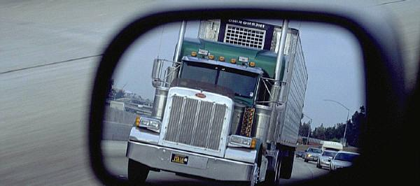
RECOMMENDATIONS
THE PAST DOES NOT REFLECT THE FUTURE

Slide 39
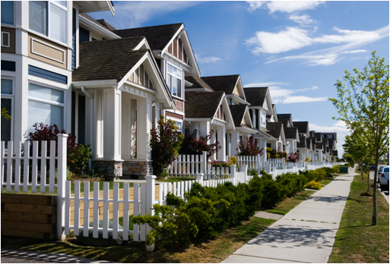
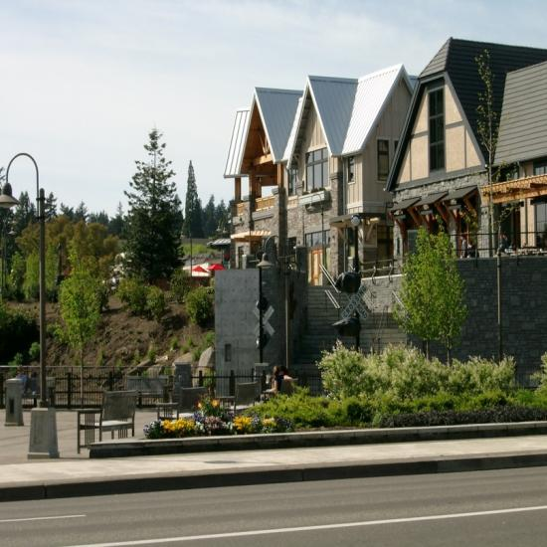

Responding to Change
Profound and permanent changes are taking place in America that are altering consumer behavior and motivation.
Market Depth
Real Estate Markets
and Demographics
Macroeconomic
Environment
Consumer
Confidence
Geopolitical
Environment
Consumer
Attitude
Political and
Regulatory
Environment
Consumer
Behavior
Developers who understand and appropriately respond to these changes will be the successful community builders of the future. Those who do not will fail.

Slide 40
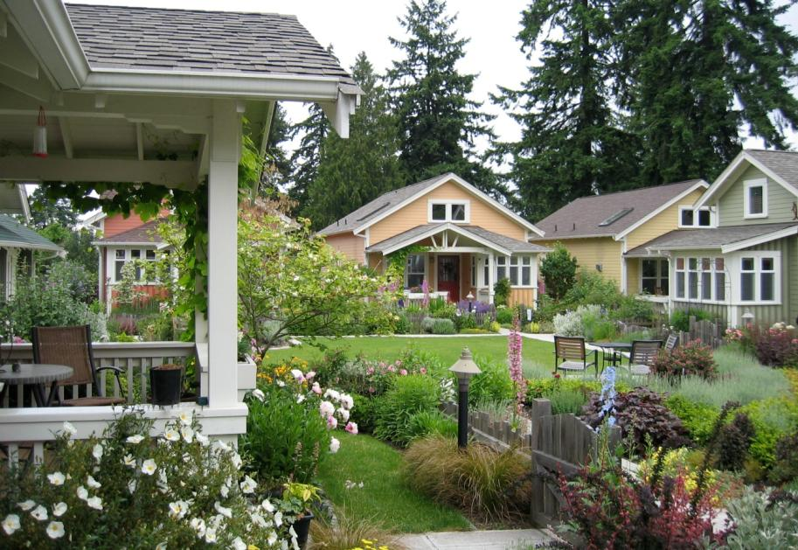
Value Proposition
To define, design, and implement a mixed-use residential lifestyle community that meets the financial expectations of the investor and developer and results in a high level of consumer satisfaction and emotional attachment.

Slide 41
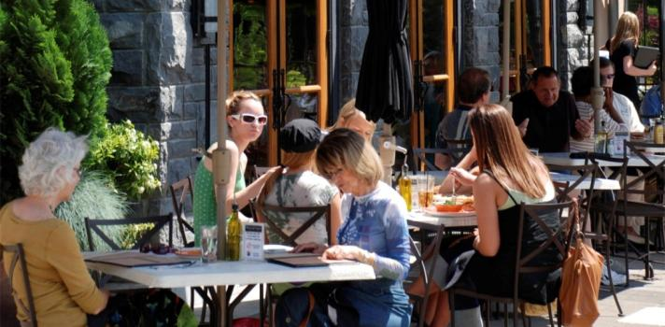
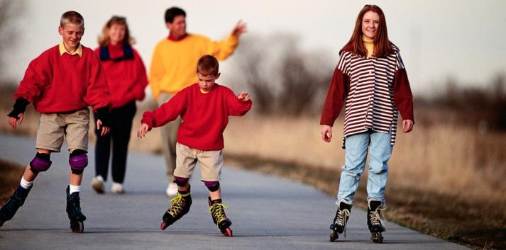
The Neighborhood is the Amenity
Access to social and recreational opportunities is crucial for housing.
.
Anywhere Office
Neighborhood Dining
Neighborhood Dining
Outdoor Rooms
Recreation

Slide 42
Micro Trends – What’s In?
Residential communities that make sustainable choices and provide energy efficient homes.
Water features (fountains, canals, lakes)
Homes clustered around open space
Pedestrian and bicycle friendly
Narrow streets through neighborhoods

Slide 43
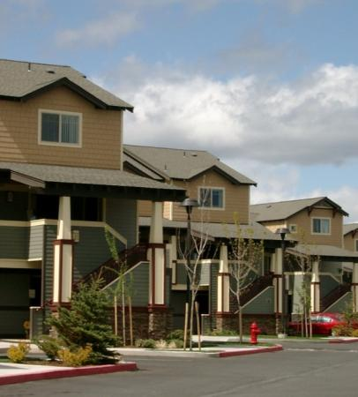
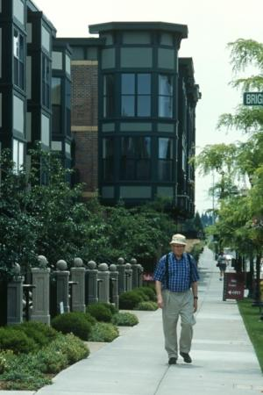
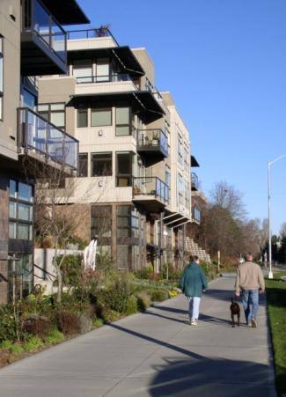
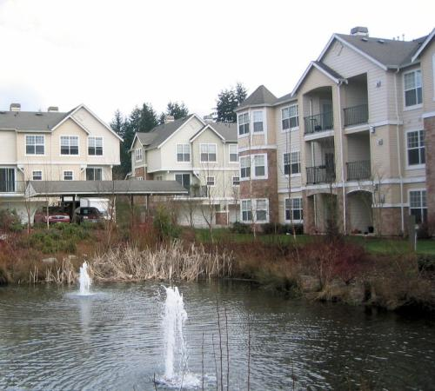
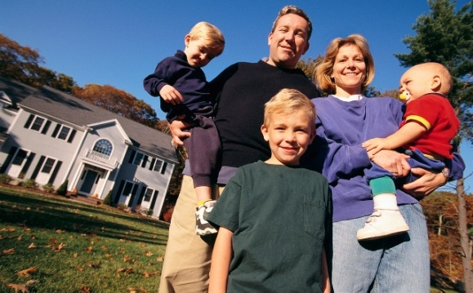
The Sum of Distinct and Diverse Neighborhoods…
….creates a complete community.

Slide 44
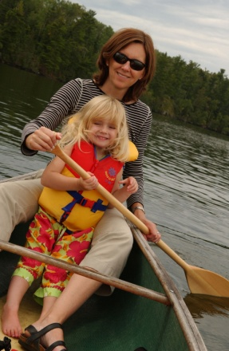
Waterfront Development Concept and Program
PUBLIC USES
  Ebey Slough Trail
  Public Park
  View Points
  Estuary Access
  Connection to Tribal waterfront
  Flexible Events Lawn
PRIVATE USES
  Housing – target of 300 units –
  both owner and renter
  Restaurant on the waterfront
  Brew Pub or other popular dining
  Light Watercraft Center and Bike Rental
  $65 to $75 Million Private Capital

Slide 45
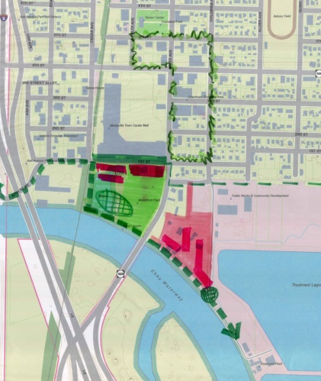
Priority Actions Next Five Years
Improve 1St west of SR 529
Construct Ebey’s Slough Trail
Prepare mill site for approximately 250 new apartment units
Master plan and prepare site for park and mixed use development
Continue to support downtown businesses
5
1
4
3
2

Slide 46
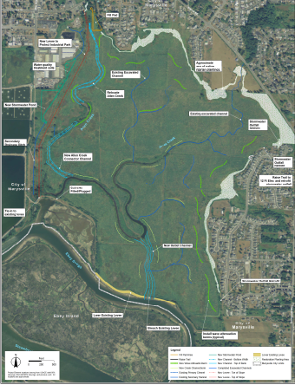
Qwuloolt Project
Qwuloolt Project offers great opportunity for the City of Marysville:
  Stream restoration
  Estuary restoration
The project will draw a large tourist base—ties in very well with water trail and upland trail improvements.

Slide 47
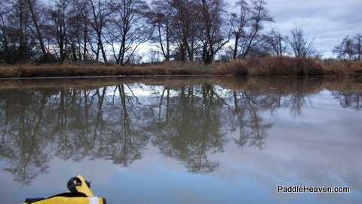
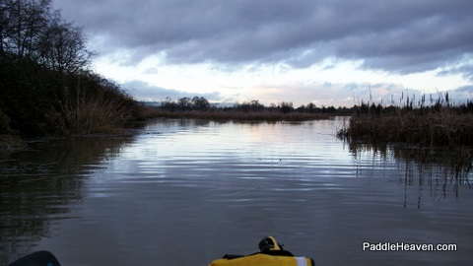
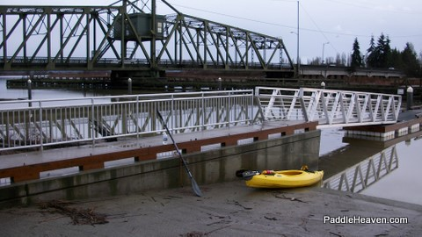
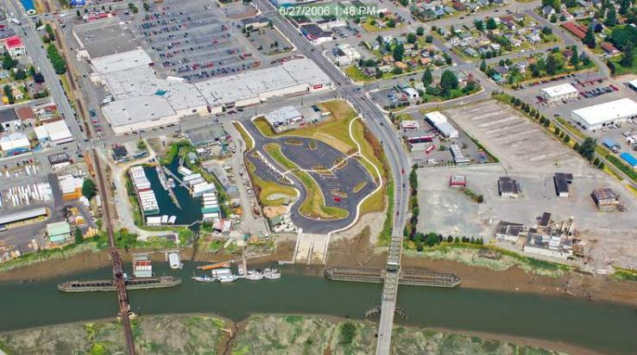
Paddling in Ebey Slough

Slide 48
Ebey Slough – Paddler Comments
Boat ramp is scratchy cement. Need to wade in and out.
Noisy traffic. I wear hearing protection. Bring an IPod?
Boat and jet skiers noise wakes. Winter has far less boat traffic. Winter is great. Less people roaring on the water.
River flow current tides to deal with.
Can be windy. Some protection in the more narrow side channels.
Smell from Cedar Grove Compost. No smell from the sewage lagoons. Can't really see them from the water level.
Know the route(s) study a map.
Lots of birds of prey to see.
Choose a less extreme tidal day. Can visit more areas that are mudflats at low tide.
Few exits from water due to blackberries and swamp conditions.
There are no services on the water trail(s).
Launch sites provide good parking, restrooms and picnic areas and close to groceries.
Close to the Seattle metro areas.
Cold water prevails be prepared.
Camping not allowed in the wetlands.
RECOMMENDATIONS
Work with paddler groups and media
Provide a float inside/outside existing boat ramp floats
Plan on winter use – open facilities, interpretive info etc.
Work with partners on facilities along the water trail
Tie in improvements with upland trail improvements
Marketing!
Upland improvements planned on waterfront will further enhance the visitor’s experience – trails, brew pub, restaurant, etc.
47

Slide 49
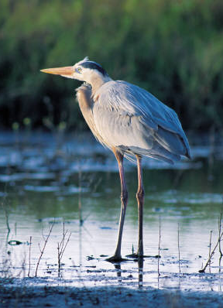
Bird Watching in Ebey Slough
The Ebey Slough is a top location for bird watching in the State of Washington.
Some of the species sighted include:
Bald Eagle
Barred owl
Redtail hawk
Ducks (various species)
Geese
Coots
Sparrows
Stellers jay
Robins
Redwinged blackbirds
Marsh wrens
Gold finch
And many more…
Source: Lipinski, Daniel, “Ebey Island”. October 23, 2011. Tweet. University of Washington
http://mailman1.u.washington.edu/pipermail/tweeters/2011-October/086407.html

Slide 50
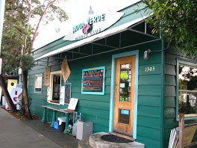
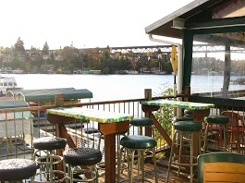
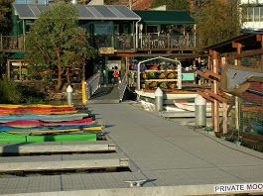
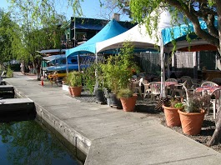
An Example: Agua Verde – UW Boat Street
Experience all that Seattle has to offer at Agua Verde Cafe & Paddle Club. Located on Lake Union's Portage Bay, we're the only place in the city where you can enjoy a scenic paddle and then relax with a delicious meal of Baja-inspired Mexican fare on our outdoor deck. Unwind with one of our signature margaritas or enjoy one of our daily specials – you'll have earned it after your paddle!

Slide 51

City of Marysville Waterfront Park
The ramp is used by boaters, fishermen and hunters as well as kayakers.
Recommend the City install floats for non-motorized boats.
City should work with enthusiasts to market and improve the park and the proposed trail.

Slide 52

Site Context & Trail Connections
Waterfront trail connections will provide access to nearby amenities.
Sidewalk improvements and on-street bike lanes will provide better access to neighborhoods.
Special viewpoints can be set up within the park and greenway.
I-5 freeway
State St.
railroad corridor
waterfront park
Ebey Slough

Slide 53

Park & Mixed-use Alternative A West of State St.
• Activate the waterfront with a light watercraft center and bike rental facility.
• Create flexible open space for festivals and concerts.
• Reconfigure marina pond for fly casting classes & competitions.
• Add more single car parking to boat ramp parking lot.
• Develop mixed-use housing & limited retail along 1st St.
mixed use development
casting pond
flexible lawn area
light watercraft center & cafe
Ebey Slough

Slide 54




Waterfront Park Activities
• Biking
• Fishing
• Boating
• Festivals
• Concerts
• Fly-casting
• Picnicking
• Kid’s play

Slide 55

Park & Mixed-use Alternative B West of State St.
• Activate the waterfront with a light watercraft center and bike rental facility.
• Create a flexible open space for festivals and concerts.
• Add more single car parking to boat ramp parking lot.
• Develop a variety of mixed-use housing & retail along 1st St. to create a new neighborhood.
mixed use development
flexible lawn area
light watercraft center & cafe
Ebey Slough

Slide 56



Urban Waterfront Trails & Interpretive Markers
Examples from Vera Katz Eastbank Esplanade, Portland, Oregon

Slide 57



Interpretive, Art and Wayfinding for Place Making
• Develop a program for place making unique to the Marysville waterfront.
• Focus on natural history, natural resources, human activities & industrial past.
• Commission works of public art that represent the relevant identified themes.
• Develop a wayfinding program that includes regional maps & illustrates connections for land and water trails.

Slide 58


Compatible Development That Fits the Waterfront
Carefully consider the kind of development that will enhance the public park experience...
Emphasize a walkable community.
Consider the relationship of public space and private development so that they compliment one another.
In addition to a cafe, consider adding more seasonal retail that can energize the waterfront experience during the summertime.
Example of urban housing with front porches that compliment the public realm
Example of seasonal food & beverages

Slide 59

Downtown Transportation Plan

Slide 60

Improved Streetscape for 1st Street
First Street and the south side of Town Center Mall need significant improvement as a catalyst for waterfront development to take place.
Consider the following public street improvements:
• Landscape screening with narrow conifer trees against the blank mall facades
• Wide sidewalks and street trees on both sides of the street
• One lane of travel in each direction
• Angled parking on the south side of the street
• Landscaped setback for new development

Slide 61

East Side
SR 529
First St
Develop approximately 250 new apartments
  4 story buildings
  Surface and “tuck-under” parking
  Oriented around ample open space
Coordinate access with the City Public Works facility
Integrate with Ebey Riverfront Trail and shoreline restoration
Special viewpoint at southern end of the trail

Slide 62

East Side
Approximately 1.75 parking stalls per dwelling (typical)
4 story residential buildings with ground floor units and tuck-under parking
Ebey Riverfront Trail
Shoreline restoration
Public Works
Common open space
Viewpoint

Slide 63



Residential Examples

Slide 64


East Side Trail

Slide 65



East Side Interpretive

Slide 66
Markets Change – Start planning now…
Expansion
Hypersupply
Best
Sales Velocity
The
Real Estate
Market
Cycle
…to deliver product here
Recovery
Recession

Slide 67
Summary
Consider interest and willingness to continue
Timing is important—start now
Aim for completion in five years
Test concepts with investors and developers
Initiate detailed planning: Physical, Financial, Regulatory
Quantify costs and sources of public capital
RFQ to developers
Time public investments with private sector financial commitments

Slide 68


