Slide 1
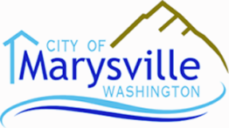
2015 Comprehensive Plan Update
Public Hearing

Slide 2
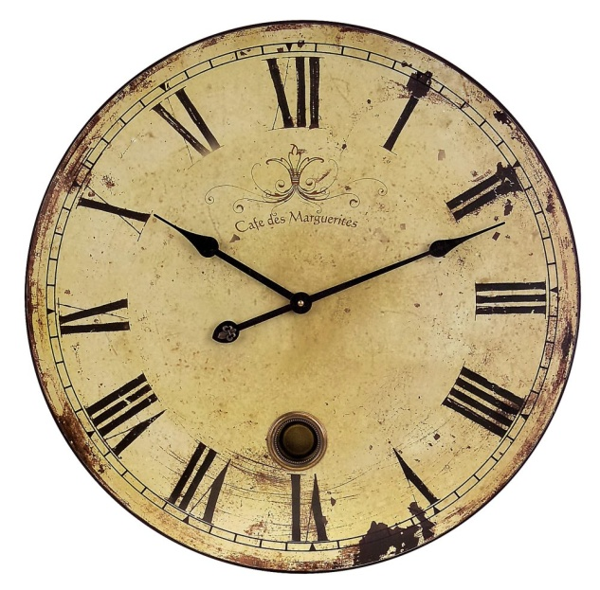
What is a Comprehensive Plan and Why Is It Being Updated?
A Comprehensive Plan is a document adopted pursuant to the Growth Management Act (GMA), Chapter 36.70A RCW, which provides land use designations, and goals and policies regarding land use, housing, the environment, capital facilities (water, sewer, stormwater), transportation, and utilities.
GMA requirement. Foundation of local planning and land use regulations.
Cities must periodically review. Major update required every 8 years.
City must designate an urban growth area(s) (UGA) where urban growth should occur.
Sufficient areas and densities designated to permit the urban growth that is projected to occur in the city for the next 20 year period.
The 20 year period covered by the current update is 2015 to 2035.

Slide 3
Current Population and 2035 Potential Population
2013 UGA population is 62,309 people. City needs to accommodate a 2035 UGA population of 87,798 (i.e. 25,000 people or 41% population growth); however, this is only 7,367 more people in 2035 than were previously planned for by 2025.

Slide 4
Current Employment and 2035 Potential Employment
2011 UGA employment estimate is 12,316 workers. City needs to accommodate 2035 employment of 28,113 people. The Smokey Point Master Plan area, which is slated as the City’s major employment center, has capacity to accommodate 10,000 jobs (about 63% of growth in employment capacity). Other likely job growth areas are Lakewood and Sunnyside-Whiskey Ridge.

Slide 5
1.0 Introduction, 2.0 Vision, and 3.0 Public Participation
1.0 Introduction Amendments are limited to a brief description of the 2015 update and references to the most recent version of plans which have been adopted such as the Water and Sewer Comprehensive Plans.
2.0 Vision – Marysville: Past, Present and Future – Amendments consist of updates to reflect expansion of, and major changes within, the City from 2005 to 2015.
3.0 Public Participation – Amendments consist of a new section which outlines the general public participation process for Comprehensive Plan amendments and a description of the public participation process for the current update.

Slide 6
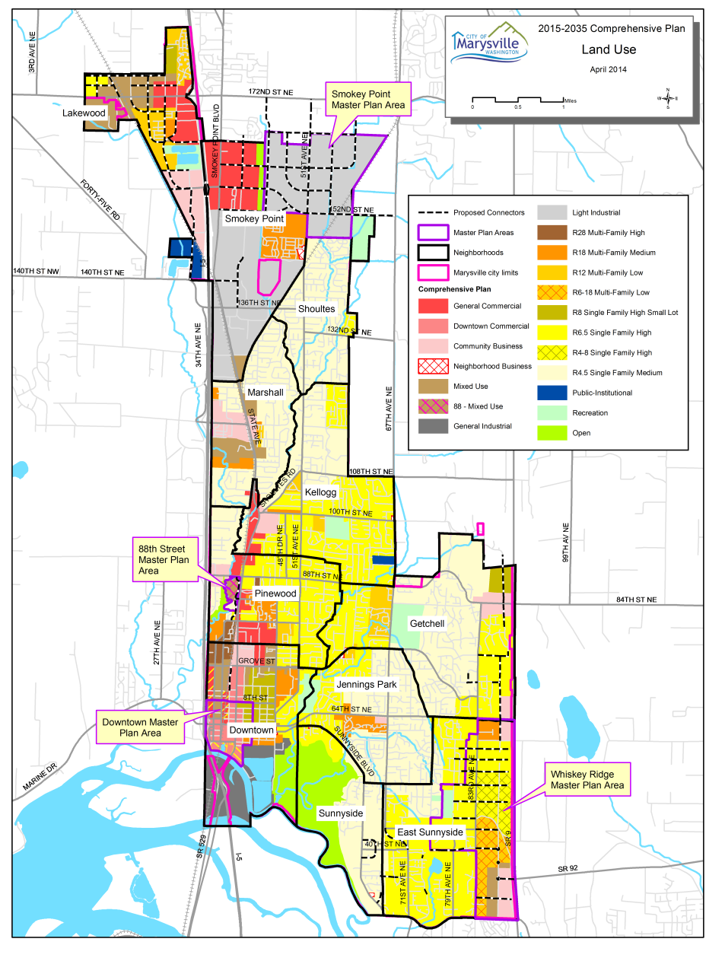
4.0 Land Use Element - Amendments
4.0 Land Use Element – Establishes City’s character, quality and pattern for land uses. Amendments include:
Updating population and employment information to be consistent with PSRC’s Vision 2040 Regional Growth Strategy;
Updating maps and information on anticipated transportation, infrastructure, parks projects and amenities in each neighborhood;
Incorporating changes to State law;
No area-wide zoning changes or major policy changes are proposed. Total land to be rezoned is 69.4 acres (less than half a percent of the 13,527 acres of UGA.

Slide 7
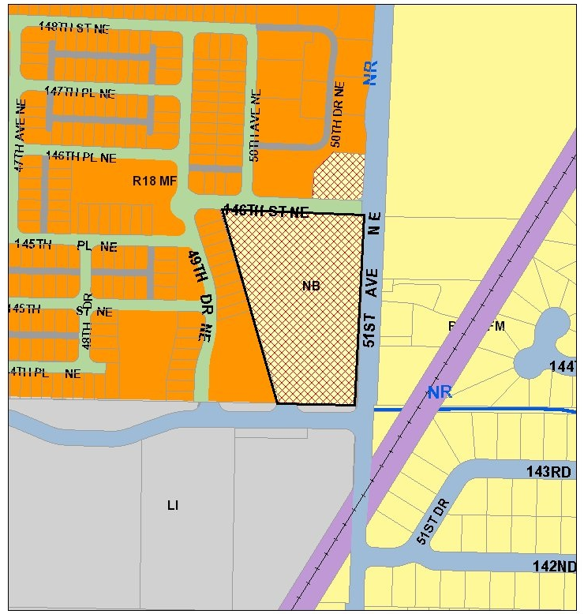
4.0 Land Use Element – Citizen Rezone Request 2
NW corner of 51st Avenue NE & 144th Street NE.
Approx. 5.06 acres.
Presently zoned Neighborhood Business.
Request rezone to R-18 or R-28.
Recommendation: rezone to R-18.

Slide 8
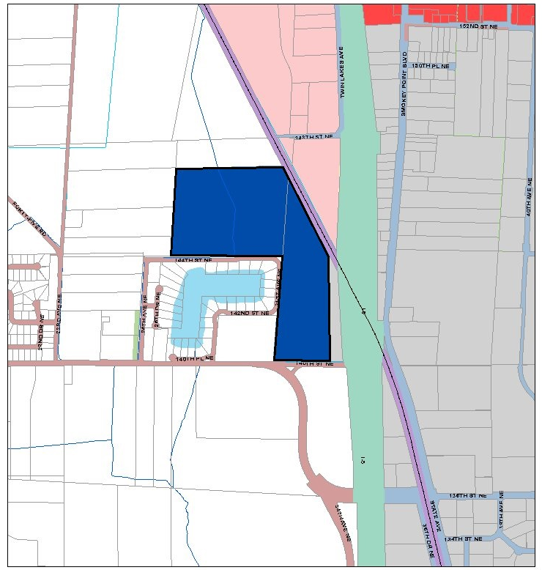
4.0 Land Use Element – Citizen Rezone Request 3
West of I-5 and BNSF railroad, and north of 140th Street NE.
Approx. 58.45 acres (2 parcels).
Presently zoned Public-Institutional(PI).
Recommendation: retain existing PI designation but identify as eligible to rezone to R-4.5 subject to a traffic analysis that assesses 140th Street as well as the future connector from 140th Street to 172nd Street including its alignment.

Slide 9
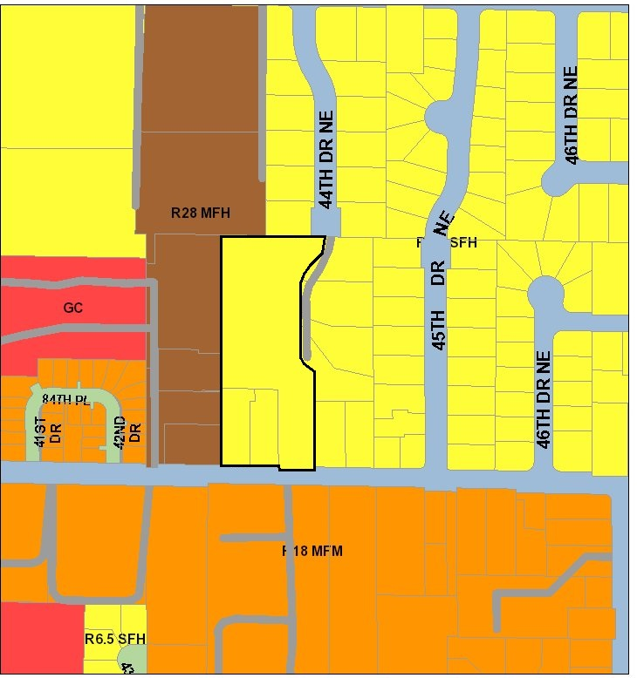
4.0 Land Use Element – Citizen Rezone Request 4
4321- 4407 84th Street NE
East of State Avenue along north side of 84th Street NE.
3.5 acres (3 parcels).
Presently zoned R-6.5 Single Family, High Density.
Request rezone to R-18 or R-28.
Recommendation: rezone to R-12.
Surrounded by multi-family on west & part of north and single family zoning along rest of north and east.

Slide 10
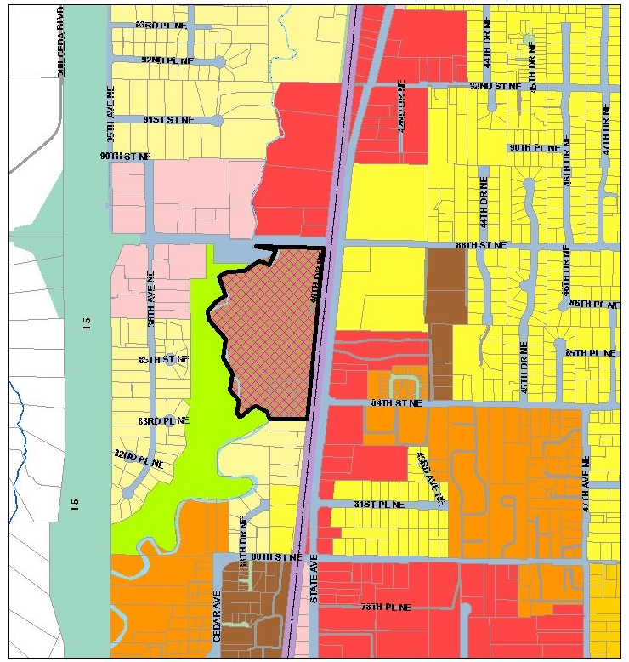
4.0 Land Use Element – Citizen Rezone Request 5
3824 88th Street NE
Southwest corner of 88th Street NE and State Avenue/BNSF railroad.
23.18 acres (4 parcels)
Bordered by single family to south and stream corridor to west.
Presently zoned 88-MU (Mixed Use).
Request rezone to R-28 Multi-family, High Density.
Recommendation: retain 88-MU.

Slide 11
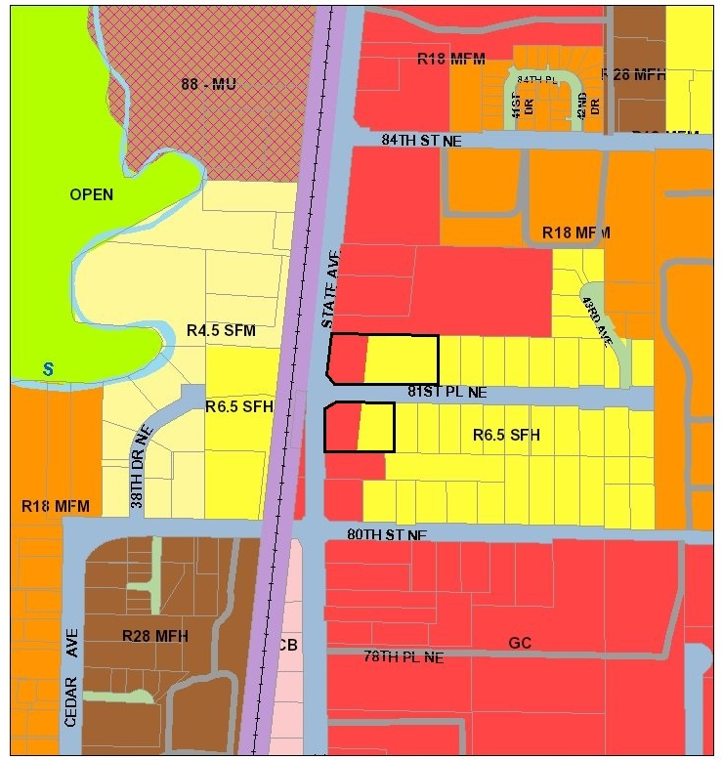
4.0 Land Use Element –
Staff-Initiated Rezone 1
4011 81st Place NE.
2.24 acres (2 parcels).
East side of State Avenue along 81st Place NE.
Split-zoned with approx. 0.91 acres General Commercial (GC) and 1.33 acres R-6.5 Single Family, High Density.
Entire north parcel church.
Entire south parcel church annex/ assembly building.
Recommendation: rezone both parcels to be entirely General Commercial.

Slide 12
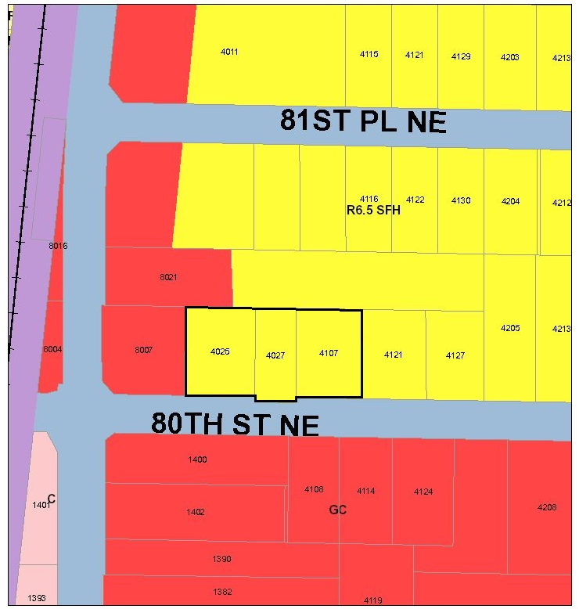
4.0 Land Use Element –
Staff-Initiated Rezone 2
4025, 4027 & 4107 80th Street
East of State Avenue along north side of 80th Street NE.
0.89 acres (3 parcels)
4025 80th Street NE –automotive repair shop and professional offices.
4027 80th Street NE and 4107 80th Street NE – professional offices.
Recommendation rezone from R-6.5 to General Commercial.

Slide 13
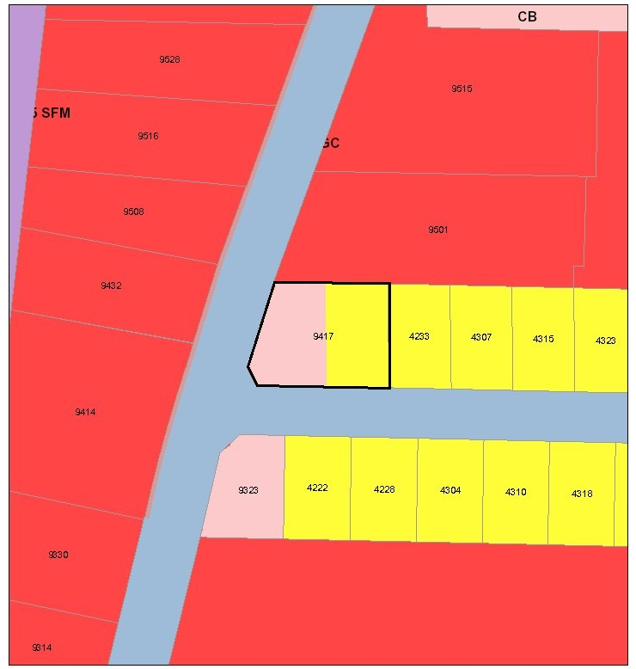
4.0 Land Use Element –
Staff-Initiated Rezone 3
9417 State Avenue
East side of State Avenue and north of 94th Street NE.
0.45 acres
Split-zoned with approx. 0.24 acres zoned Community Business and 0.21 acres zoned R-6.5 Single Family, High Density.
Developed with former bank/pharmacy.
Recommendation: rezone entire parcel to Community Business.

Slide 14
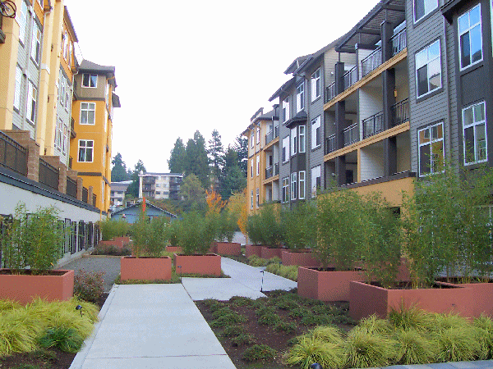
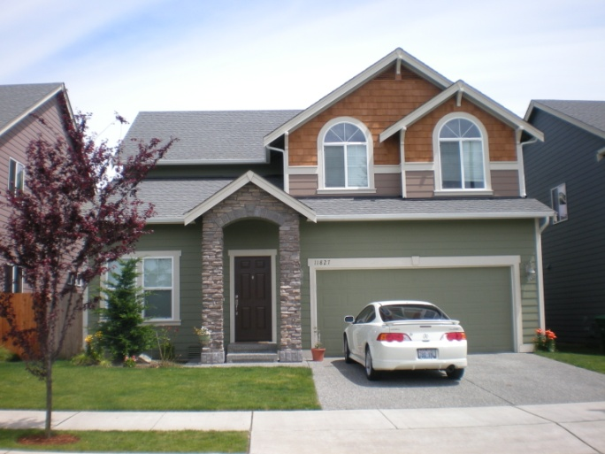
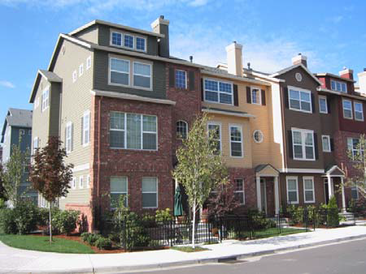
5.0 Housing Element
5.0 Housing Element – Provides an inventory and analysis of existing household characteristics, housing stock and characteristics, projected housing needs, and goals and policies. Update incorporates the Housing Profile prepared by the Alliance for Housing Affordability that includes an updated:
Analysis of existing household characteristics and housing stock;
Housing inventory; and
Analysis of housing affordability.

Slide 15
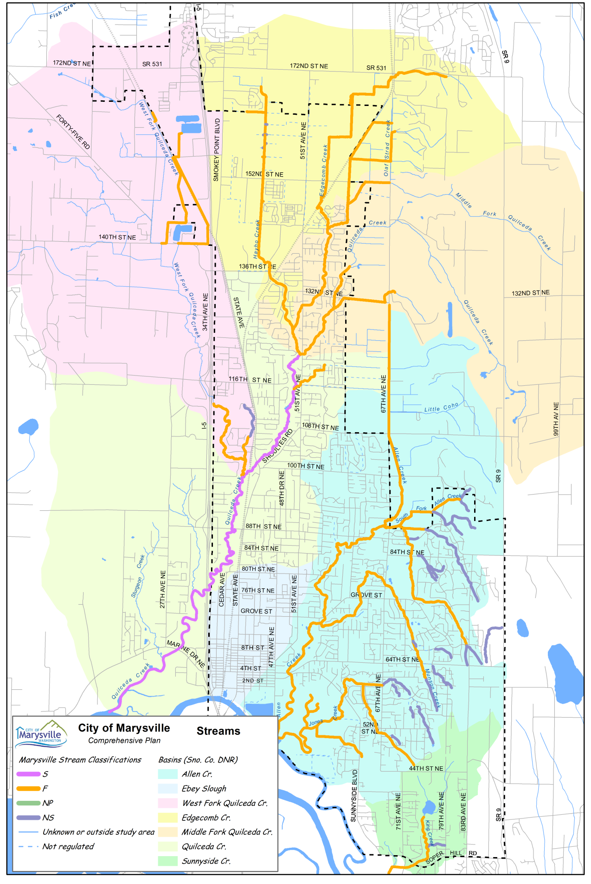
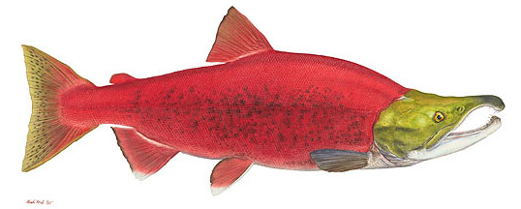


6.0 Environmental Element – Amendments
6.0 Environmental Element - Foundation for the City’s CAO, SMP, and other regulations. Amendments consist of incorporating strategies and policies that pertain to climate change.
The climate change strategies and policies build off of City Council Resolution 2286.
Maps also updated and minor text changes.

Slide 16
7.0 Economic Development Element – Amendments
7.0 Economic Development Element – Analyzes City’s economy and “formulates… policies to move the community towards its goals.” Updates include:
Current employment estimates and 2035 targets;
Annexations, adoption of Smokey Point Master Plan and pursuit of Manufacturing Industrial Center with Arlington;
Completion of infrastructure projects and identification of infrastructure projects that facilitate development;
Major developments since 2005 such as the Gateway Shopping Center and Lakewood Crossing;
Current employment and wage information; and
Agency, entity, etc. name changes.

Slide 17
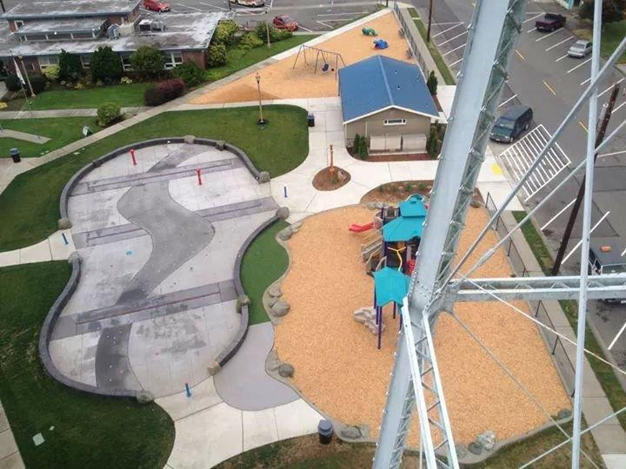
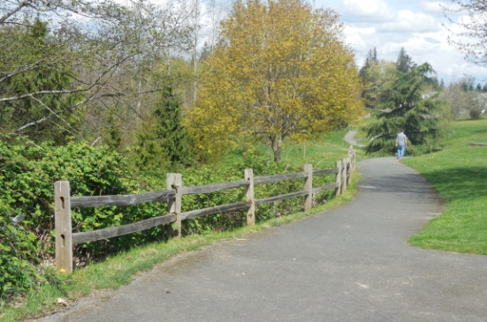
9.0 Parks and Recreation Element – Amendments
9.0 Parks and Recreation Element – Direction to Marysville Parks and Recreation Department. Allows continued eligibility for Recreation Conservation Office (RCO) grants. Amendments:
Public participation and recreation survey background;
Structure of dept., budget, and associated bodies;
Inventory of parks and trails that reflect new and annexed parks and trails;
Individual park and trail descriptions including amenities, management issues, planned improvements, and capital facility priority score;
Supply and needs analysis. Strategies to meet needs;
Policies pertaining to open space and critical areas specifically new policies PK-23 through PK-40.

Slide 18


10.0 Utilities Element - Amendments
10.0 Utilities Element – Covers infrastructure defined as utilities in the Growth Management Act (GMA): electricity, gas, telecommunications, and cable television. Amendments reflect changes since 2005, and infrastructure improvements through 2035.
Electricity utility update provided by the Snohomish Public Utility District No. 1 (PUD) and the gas utilities update provided by Puget Sound Energy (PSE).
Comprehensive background information on their respective utility;
Utility’s goals and objectives;
A description of how and where the utility operates;
An overview of regulatory oversight;
A description of existing facilities, and anticipated infrastructure needs generally and within the City of Marysville; and
Conservation measures employed by the utility.

Slide 19
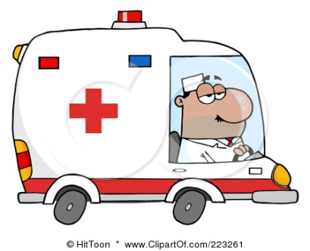

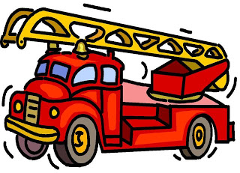
11.0 Public Facilities and Services Element – Amendments
11.0 Public Facilities and Services Element – Police and fire protection and other governmental services are “public services”. Water, storm and sanitary sewer systems, streets and associated improvements are “public facilities.”
Amendments consist of updating each section to reflect existing facilities and the facility, service, or infrastructure needs that are anticipated and which have been identified within existing plans. Specifically:
The fire and police protection and library services reflect existing facilities and anticipated future needs;
Incorporates 2014-2019 school capital facilities plans; 2009 Water Comprehensive Plan; 2011 Sewer Comprehensive Plan; 2009 Surface Water Comprehensive Plan; and
Solid waste section reflects accounts currently served and anticipated needs for waste collection trucks and sanitation personnel when accounts in CMA are transferred from Waste Management to the City Sanitation Division in 2017.

Slide 20
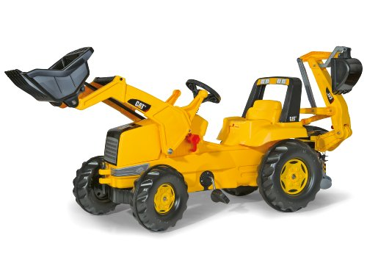
12.0 Capital Facilities Plan and
13.0 Glossary
12.0 Capital Facilities Plan – Amendments to the Capital Facilities Plan reflect the City’s capital construction and purchases for the six year period from 2015 to 2020. This generally includes any structures, improvements, pieces of equipment, or other major assets which are anticipated to be acquired within that timeframe.
13.0 Glossary –Amendments consist of additional definitions pertaining to housing and housing affordability; recreation; and essential public facilities.

Slide 21
Comprehensive Plan Wrap-Up
SEPA Addendum issued and 60-day Notice of Intent to Adopt Amendments sent to Department of Commerce on May 26th.
City Council briefing July 6th.
City Council adoption July 27th.
Questions?

