Slide 1

2024 Comprehensive Plan Update
Overview for February 7, 2022
Economic development committee meeting

Slide 2
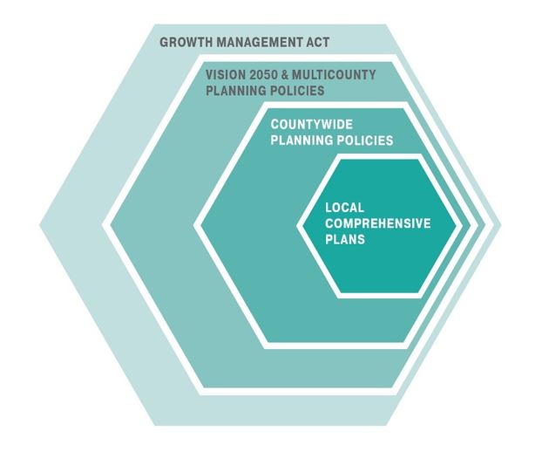
State, Region, County, City Alignment
Growth Management Act
VISION 2050 & Multi-county Planning Policies
Countywide Planning Policies
Local Comprehensive Plans

Slide 3
Comprehensive Plan Periodic Updates
Community
Vision
Comprehensive Plan
Goals, policies, etc.
Implementation Actions
Zoning regulations, capital facilities, programs, partnerships, permits, budget decisions, etc.
Prior Comprehensive Plan Periodic Update: 2005
Last Comprehensive Plan Periodic Update: 2015
Next Comprehensive Plan Update due: June 2024

Slide 4
Comprehensive Plan Elements
MANDATORY
  Land Use
  Housing
  Capital Facilities Plan
  Utilities
  Transportation
  Economic Development
  Parks and Recreation
  Shoreline Management
OPTIONAL
  Conservation
  Solar Energy
  Recreation
  Subarea Plans
  Ports (mandatory for cities with annual maritime port revenues exceeding $60 million and option for those with revenues between $20 million and 60 million).

Slide 5
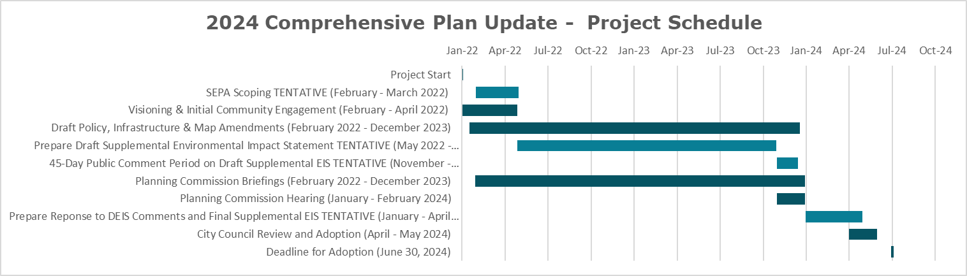
Draft Project Schedule/ Timeline

Slide 6
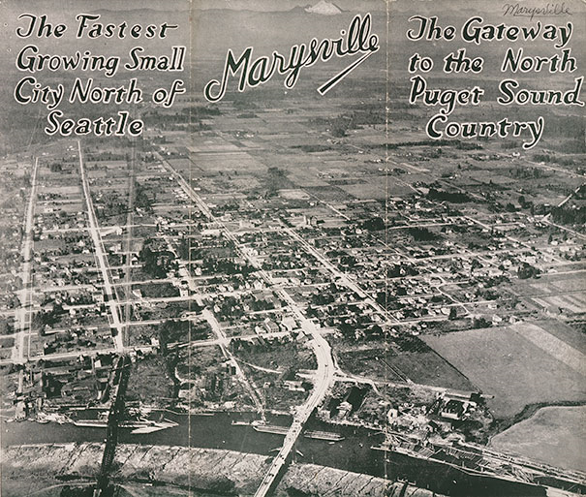
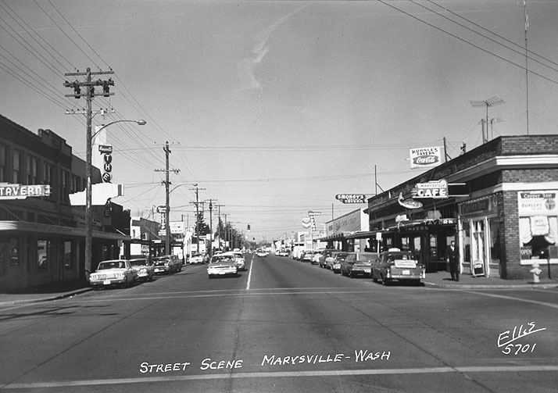
Introduction and Vision Elements
Update to be more concise and graphically appealing.
Incorporate historical imagery to include with the written history.
Growth Management Task Force (GMTF) provided feedback on the City’s six overarching land use priorities.

Slide 7

Public Participation Plan
“Each county and city planning under the act must establish procedures for early and continuous public participation in the development and amendment of comprehensive plans and development regulations” (WAC 365-196-600).
Amend old information and incorporate information relevant to the current update.
Open Houses (Zoom/in person), Planning Commission & City Council work sessions/meetings, etc.
Draft documents to neighboring jurisdictions, tribes, etc. Meet/coordinate as needed.
Robust online engagement. Initial survey. How would the public like to engage? What land use issues are of greatest interest?
Online (quarterly) surveys – visioning, general Comprehensive Plan goals, map designation changes, etc.
Use of Social Pinpoint interactive mapping software, and Idea Walls.
Availability of draft documents for comment.

Slide 8
Land Use Element
Land Use Element sets the direction of future growth in a community and is depicted on a Comprehensive Plan Map (future land use map) . The Comprehensive Plan Map is implemented via the zoning map.
A zoning change cannot be approved unless it is consistent with the future land use map.

Slide 9
2035 & 2044 Marysville Growth Targets

Slide 10
Land Use Element – Analysis
Review State Amendments and Puget Sound Regional Council’s VISION 2050 Requirements.
Review the 2044 population and employment targets.
Propose alternatives for accommodating the growth targets within the UGA (e.g. identify area for Comp. Plan map re-designations, zoning code amendments, whether UGA expansion may be necessary, evaluate UGA expansion requests and Comp. Plan map re-designation requests, etc.).
Conduct reasonable measures analysis for accommodating growth.
Update maps, charts, figures, text, policies, etc. accordingly.

Slide 11
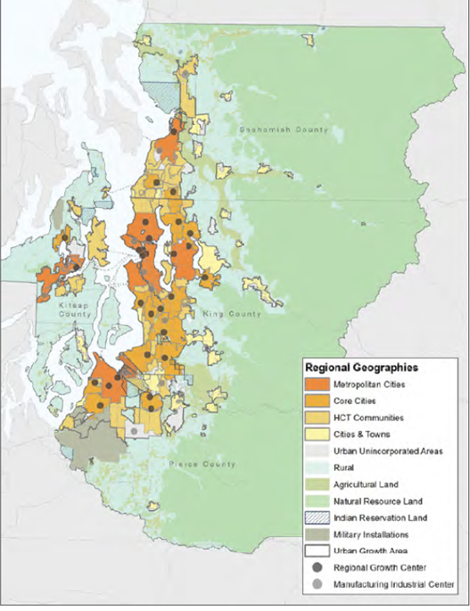
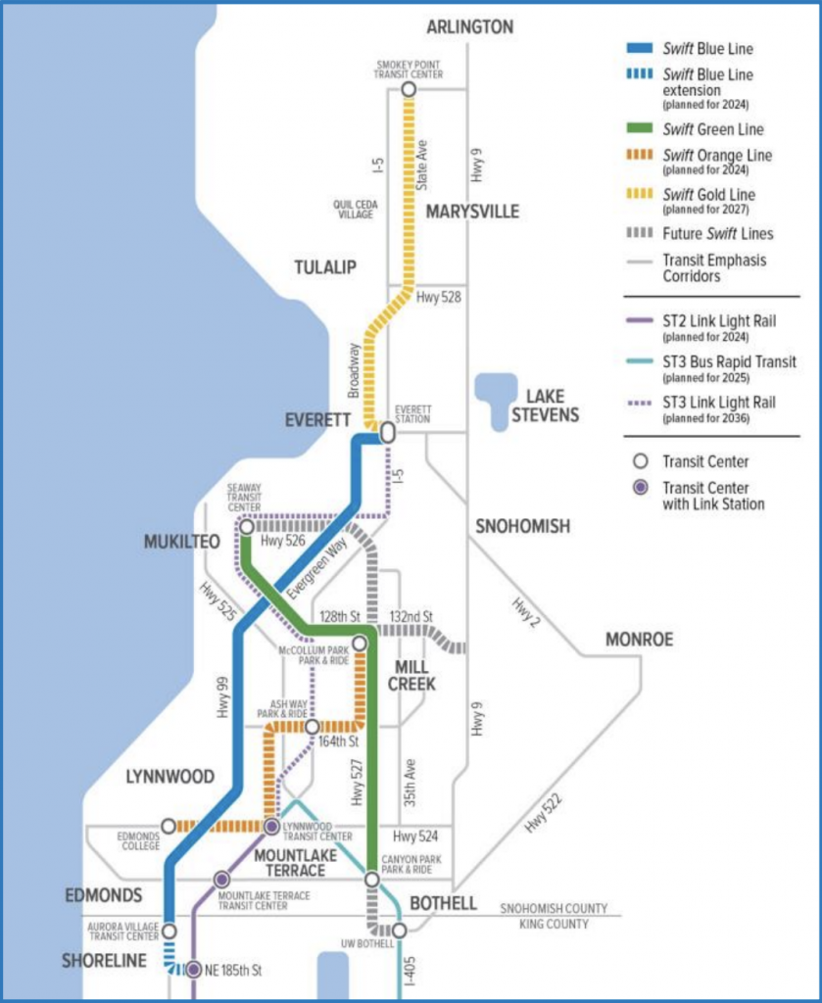
New Requirements and/or Areas with Greater Focus/Emphasis
High Capacity Transit Community – VISION 2050 focuses growth in the urbanized areas of the region, setting a goal of attracting 65% of the region’s population growth and 75% of the region’s job growth into regional centers and near high-capacity transit.
Marysville designated HCT community. Density around stations.
CT’s SWIFT Gold line planned arrival 2027.

Slide 12
New Requirements and/or Areas with Greater Focus/Emphasis
Social Equity – Seeks to provide everyone with access to the resources and opportunities they need to improve their quality of life, and address current and past inequities particularly among communities of color, people with low incomes, and historically underserved communities.
Housing Initiatives – Promote more housing, greater housing options (missing middle, etc.), and create more affordability. Support diverse housing near transit, services, and jobs. Affordability to low and very low income households.
Climate Change/Environmental Protection – VISION 2050 includes goal to reduce greenhouse gas emissions to 80% below 1990 levels. Compact growth patterns, low-carbon travel modes, protection of natural areas, climate resilience and adaptation, etc. pursued.

Slide 13
Land Use Element –
PSRC VISION 2050 Policy and Program Goals

Slide 14
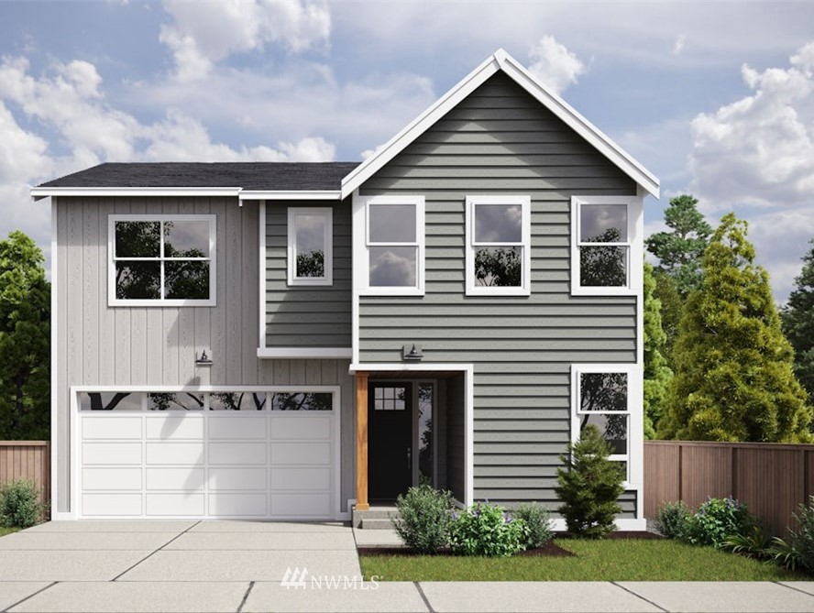
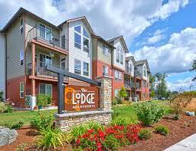
Housing Element
Update demographic and housing information (e.g. age of housing stock, family composition, age of community members, income stratification and cost burden, affordable housing units, etc.). Alliance for Housing Affordability (AHA) assisting with housing profiles.
Ensure compliance with state statutes requiring more in-depth analysis for affordable and low income housing, equity, avoiding displacement, etc.
Washington Center for Real Estate Research (WCRER) at UW producing reports that compiles housing supply affordability metrics for cities with 10,000 people.
Other sources: US Census Bureau, Snohomish County Assessor, American Community Survey, etc.

Slide 15
Housing Element –
PSRC VISION 2050 Policy and Program Goals

Slide 16
Environmental Element
Update text, maps/figures, and policies.
Address state requirements on climate change and any other new/updated requirements pertaining to the environment.
State Department of Commerce anticipated model ordinance on Climate Change.

Slide 17
Environmental Element –
PSRC VISION 2050 Policy and Program Goals

Slide 18

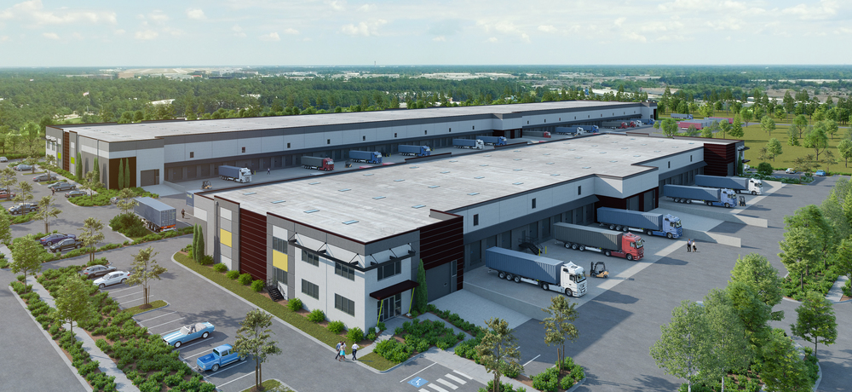
Economic Development Element
Incorporate updated economic goals, policies and data including those adopted with CIC Subarea Plan, Downtown Master Plan, etc.
Coordinate with the City’s future Economic Development Manager, Executive staff, Economic Alliance Snohomish County, etc.
Highlight job growth and goals, different initiatives and strategies for promoting economic development, etc.

Slide 19
Economic Development Element – PSRC VISION 2050 Policy and Program Goals

Slide 20
Transportation Element
Update led by PW staff/consultant. CD staff coordination. Consultant budget request 2023 -24.
Update the roadway network to include changes from last plan stemming from the Downtown Master Plan Update, Lakewood Neighborhood Master Plan, and the Cascade Industrial Center (fka AMMIC).
PW working with County staff to review roadway segments outside of Marysville City limits, in particular west and east of 156th Street NE to ensure there is a focus to direct traffic to the new 156th Street interchange at I-5.

Slide 21
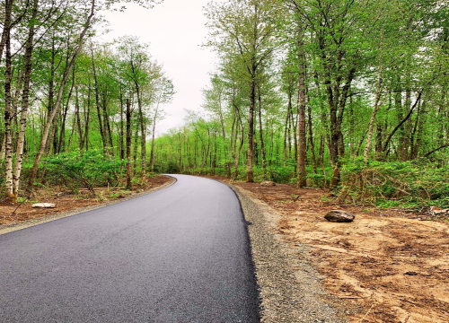
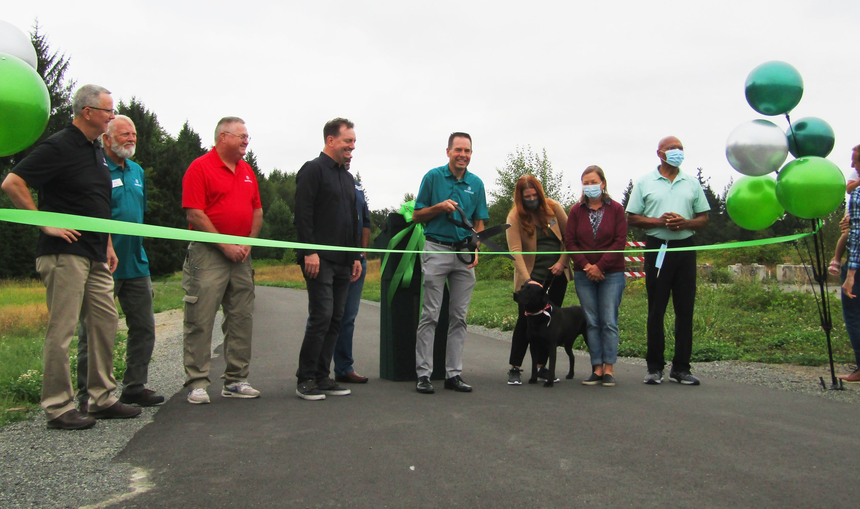
Transportation Element
  Update and improve pedestrian and bicycle routes, including trails that provide regional benefit.
  Focus on transit with new SWIFT line plus access to park-and-ride facilities.
  Anticipate increased frequency in transit service with connections to light rail.

Slide 22
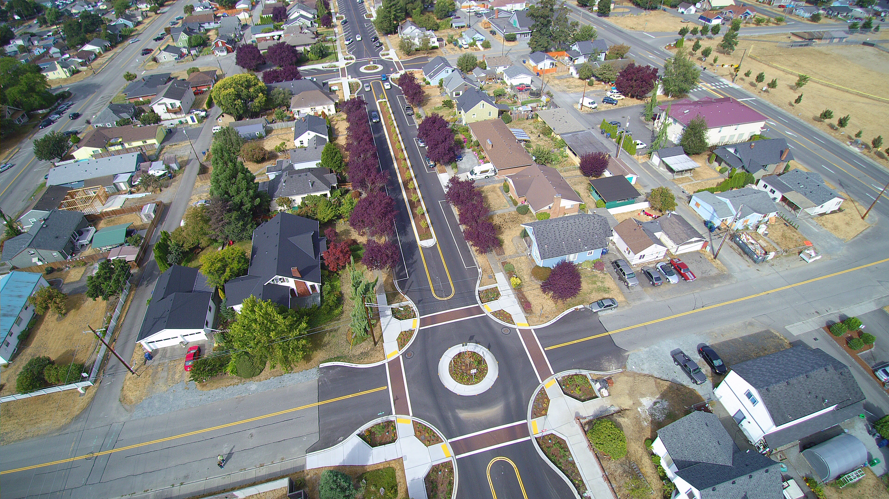
Transportation Element
  Intersection analysis and meeting concurrency with growth. Evaluate what intersections need to be addressed, within timeline and a better analysis of options.
  Review traffic impact fee calculation and compare with neighboring cities.
  Evaluate federal classification, freight routes, and other criteria that would support future grant opportunities.

Slide 23
Transportation Element –
PSRC VISION 2050 Policy and Program Goals

Slide 24
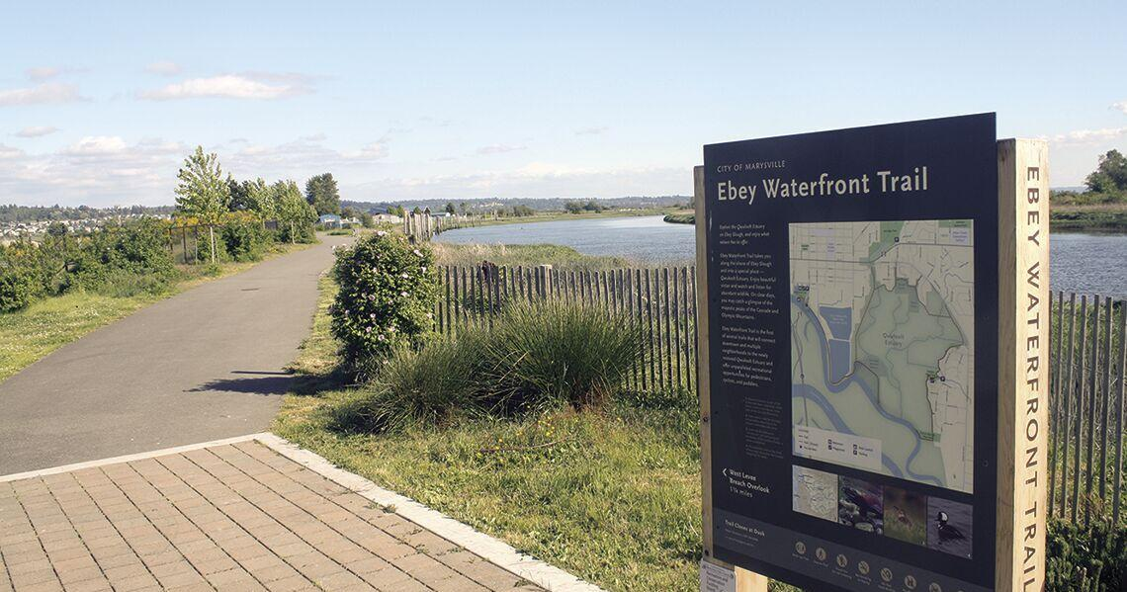
Parks and Recreation Element
Parks and Recreation just updated the Parks Plan in 2020 – which was written for 2020 – 2025.
Level of service (LOS) and concurrency standards for parks and recreation facilities may need to be updated.

Slide 25


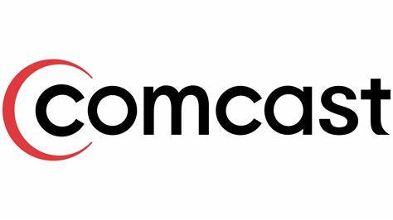

Utilities Element
The utilities element provides information on the general location, proposed location, and capacity of all existing and proposed utilities, including, but not limited to, electrical lines, telecommunication lines, and natural gas lines.
Consult with PUD, PSE, telecommunications companies, etc.
Review their planning documents and incorporate relevant information pertaining to capacity, infrastructure, etc.
Infrastructure and network information is often general in nature for security reasons.

Slide 26


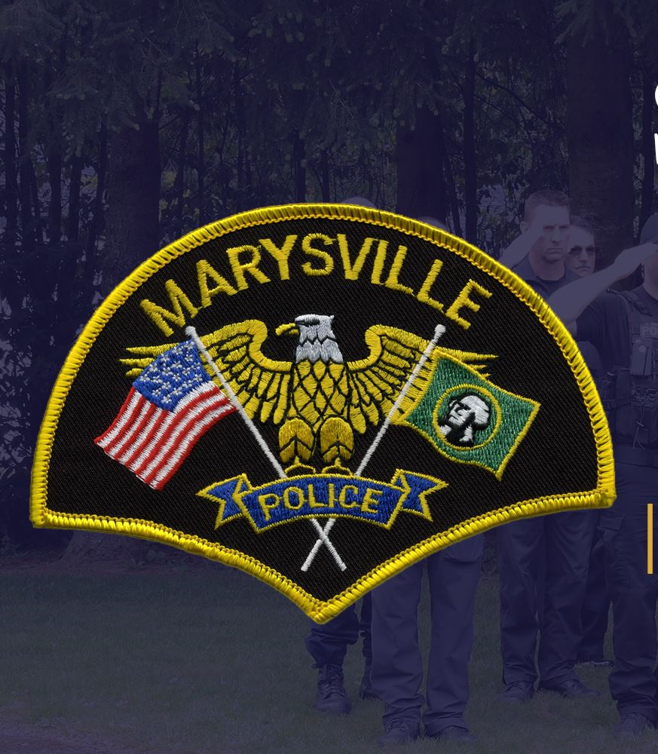
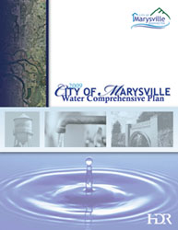
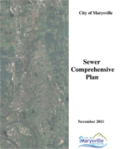
Public Facilities and Services
"Public facilities" include streets, roads, highways, sidewalks, street and road lighting systems, traffic signals, domestic water systems, storm and sanitary sewer systems, parks and recreational facilities, and schools (RCW 36.70A.030(20)).
"Public services" include fire protection and suppression, law enforcement, public health, education, recreation, environmental protection, and other governmental services (RCW 36.70A.030(21)).
Incorporate current school CFP, police, fire, water, sewer, etc. info. and coordinate with these entities, as needed.
Coordinate with Public Works to ensure adequate water and sewer capacity where zoning changes contemplated.
Streamline by referencing functional plans.

Slide 27
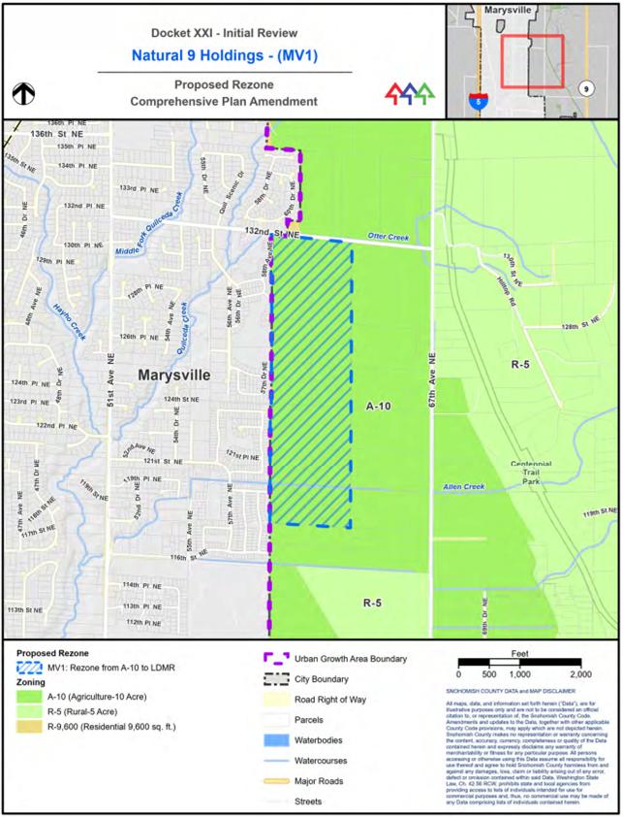
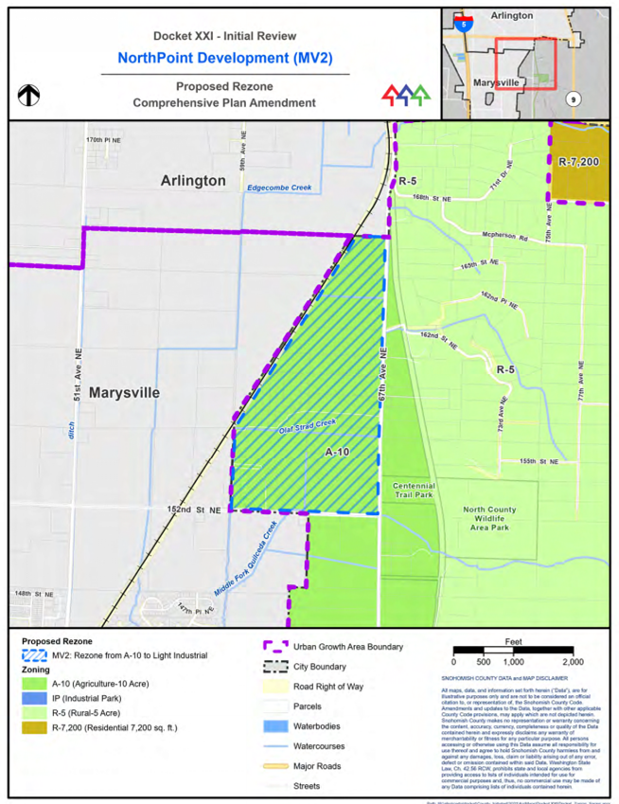
UGA Expansions

Slide 28
Resources, Questions, Comments…
Municipal Research Services Center – https://mrsc.org/Home/Explore-Topics/Planning/General-Planning-and-Growth-Management/Comprehensive-Planning-Growth-Management.aspx
Puget Sound Regional Council – www.psrc.org
Snohomish County Tomorrow – https://snohomishcountywa.gov/168/Snohomish-County-Tomorrow
Haylie Miller, Community Development Director – hmiller@Marysvillewa.gov
Angela Gemmer, Senior Planner – Long Range – agemmer@marysvillewa.gov

